Slide 1
Intro to R
NYC Workshop
[QSR]
2019- H2

Slide 2
Agenda
01 - Introduction: What is R & RStudio, R packages, Tidyverse
02 - Data Types: Vectors, coercion, data frames & tibbles
03 - Subsetting data: Select, filter, arrange
04 - Transforming data: Summarize, group by, join
06 - Tidy: Tidying data using gather() and spread()
05 - Visualization: Visualizing data using ggplot2
07 - Importing data: Importing data into R using readr
09 - Survey Analysis: Complete a basic survey analysis
08 - Best Practices: Workspace, ideas for organization, things to read
10 - Going Forward: Learning more and getting help

Slide 3
About the workshop
This is a hands on workshop designed for people who are brand new to R & RStudio and who learn best in person.
You will learn:
The basics of R and data analysis
Practice using the RStudio IDE (integrated development environment) and R Notebooks.
These materials were based on Introduction to R (2014), and https://github.com/rstudio/master-the-tidyverse (2017).

Slide 4
Introduction
01
Back to Agenda

Slide 5
Prework: Setting up your laptop

Slide 6
Pre-work: Install R + RStudio
You will first need to download and install both R and RStudio (Desktop version) on your computer. It is important that you install R first and then install RStudio second.
First: Download and install R.
If you are a Windows user: Click on “Download R for Windows”, then click on “base”, then click on the Download link.
If you are macOS user: Click on “Download R for (Mac) OS X”, then under “Latest release:” click on R-X.X.X.pkg, where R-X.X.X is the version number. For example, the latest version of R as of August 10, 2019 was R-3.6.1.
Second: Download and install RStudio.
Scroll down to “Installers for Supported Platforms” near the bottom of the page.
Click on the download link corresponding to your computer’s operating system.

Slide 7

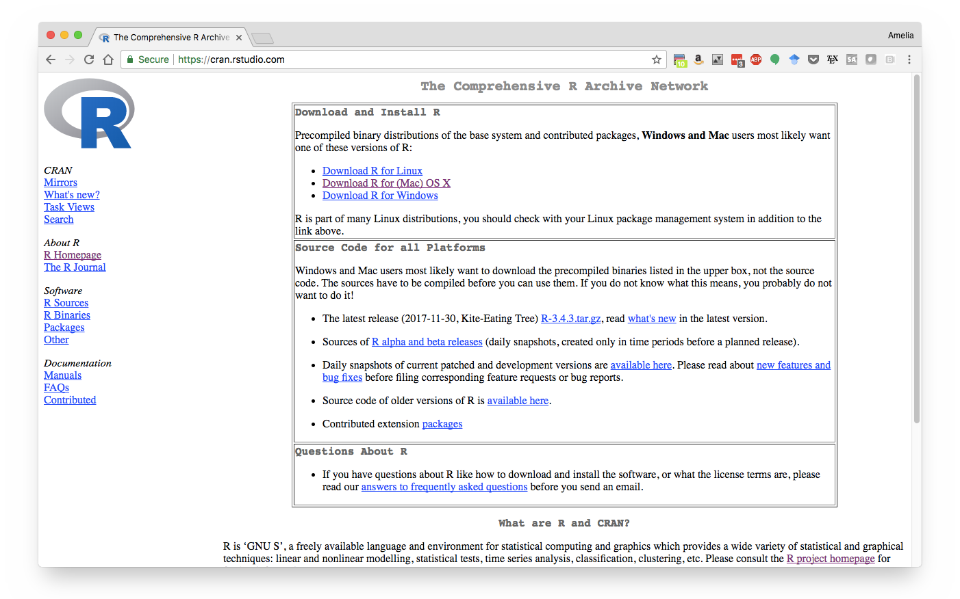

Install R
First, you will need to install R (the programming language).
Go to https://cran.rstudio.com/
Select your operating system

Slide 8


Slide 9
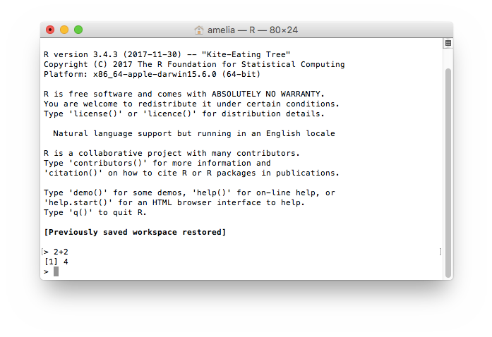
R: A computer programming language
Descends from S, Bell Labs
Evolved in university environment
Full language
...but can be used as a simple application
Designed for use with data

Slide 10
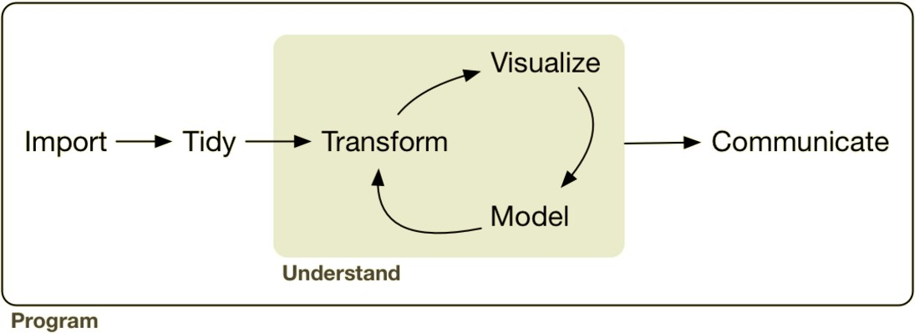
R: Designed for data
From R for Data Science by Hadley Wickham and Garrett Grolemund.

Slide 11

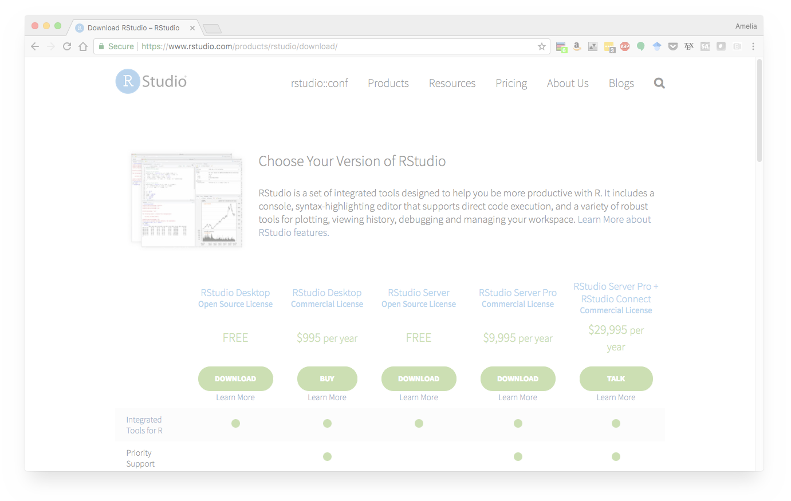
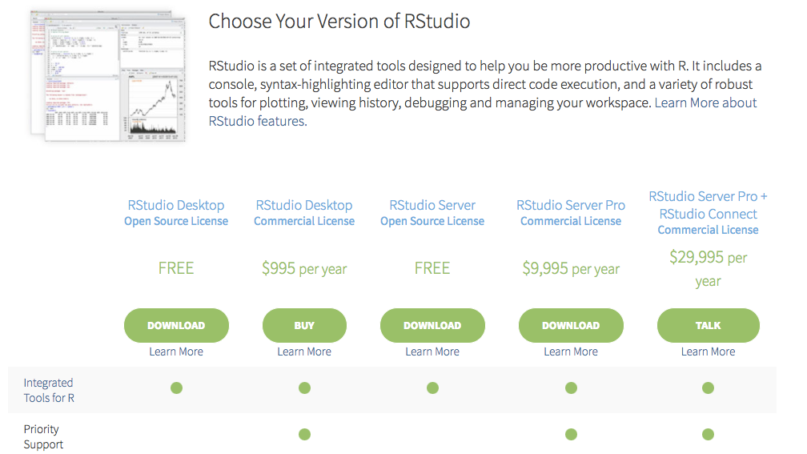

Install RStudio
Then, install RStudio (the application).
Go to https://www.rstudio.com/products/rstudio/download/
Select RStudio desktop
Select your operating system

Slide 13
RStudio: a software program
An application like Microsoft Word, Excel, etc.
Built to help you write R code, run R code, and analyze data with R
Syntax highlighting text editor, tools for plotting, version control, keyboard shortcuts, debugging tools, and much more

Slide 14
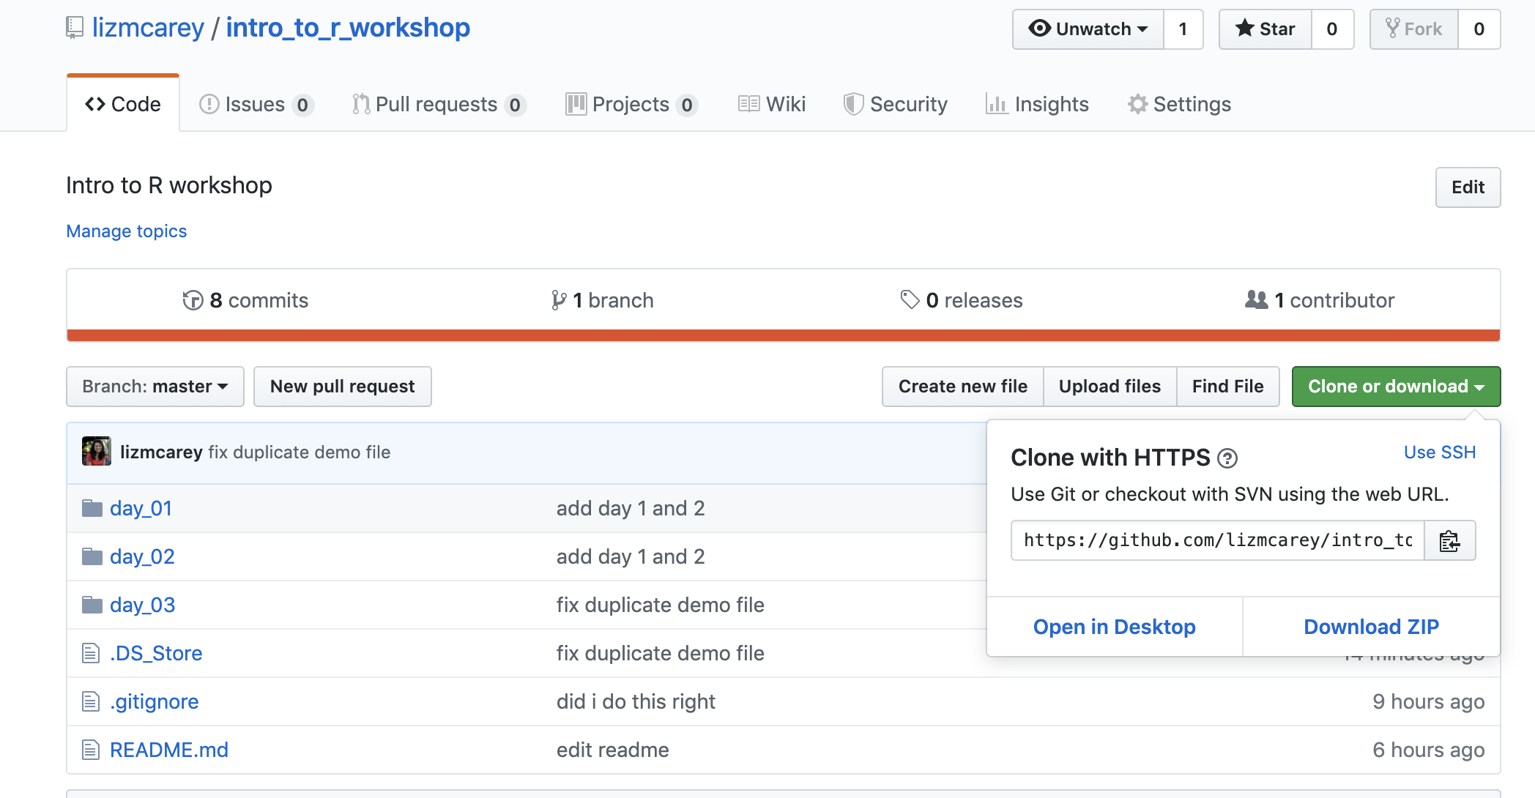
Download the workshop files
Download the materials from here
Click on "Clone or download" and select "Download ZIP"

Slide 15
Your turn
Download the Intro to R workshop from Github
Open the “01-Intro.Rmd” file

Slide 16
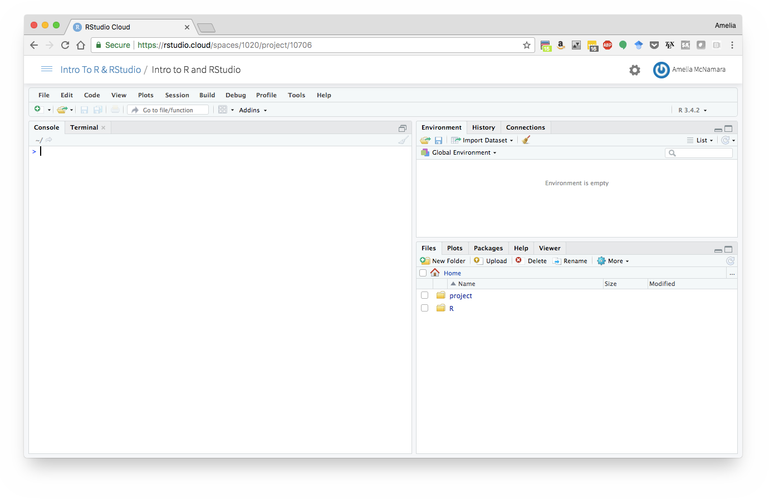
RStudio

Slide 17
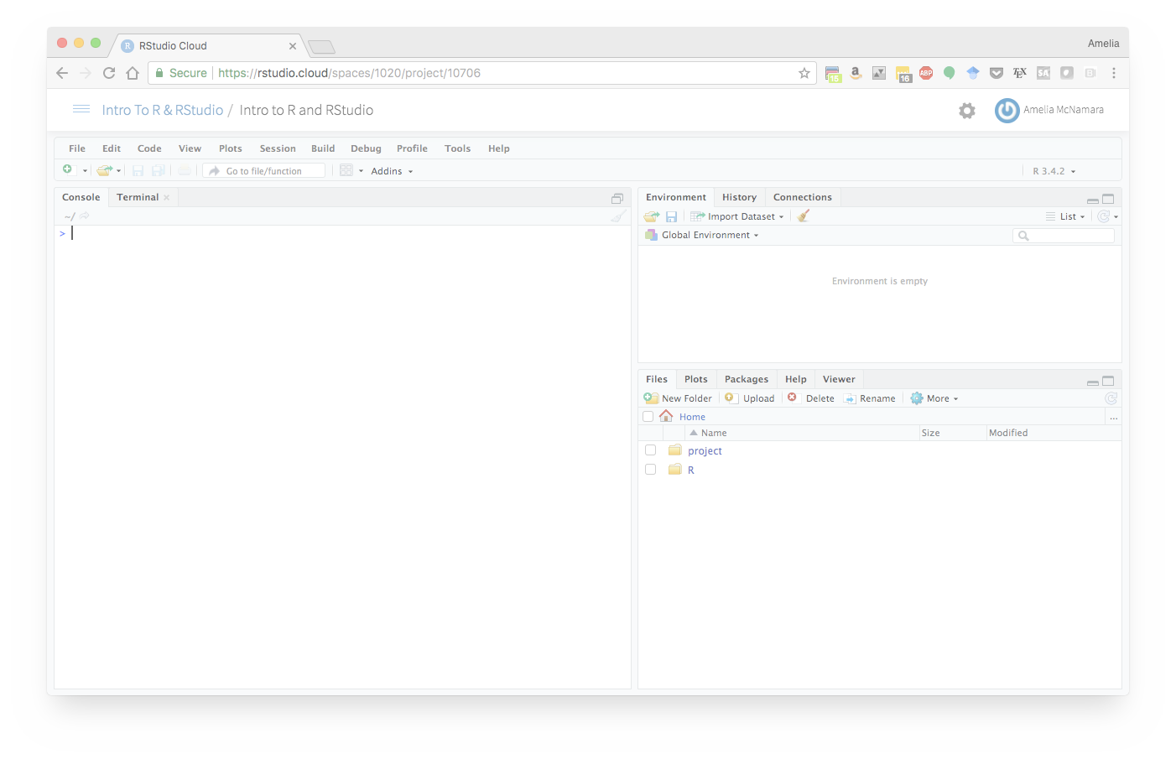
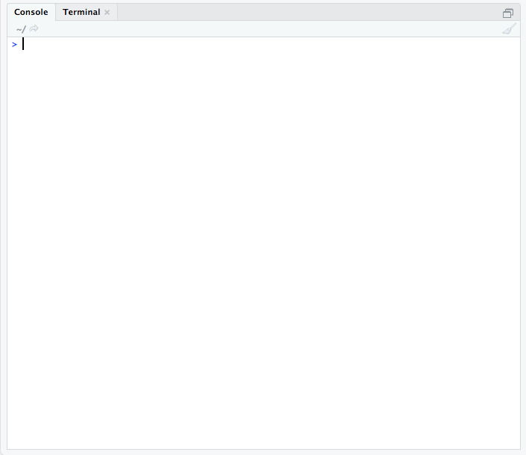
RStudio: Console
The console gives you a place to execute commands written in R

Slide 18
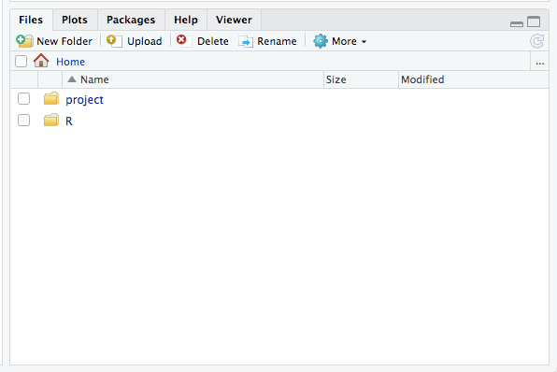
RStudio: Files pane

Slide 19
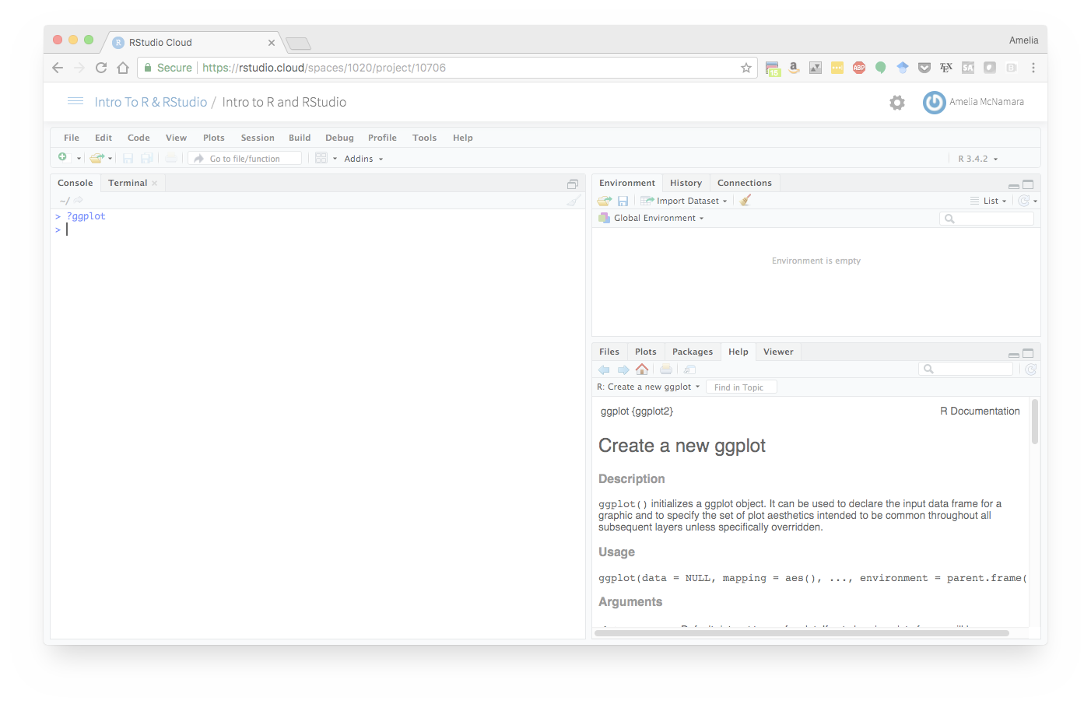
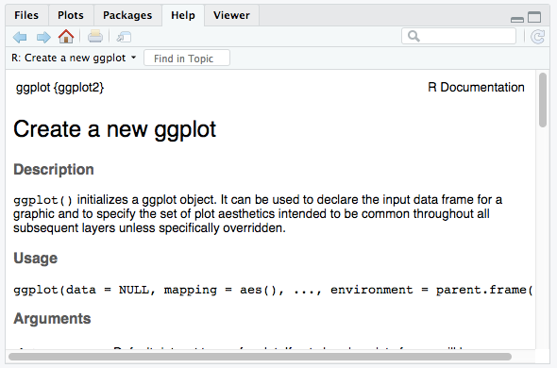
RStudio: Help pane

Slide 20
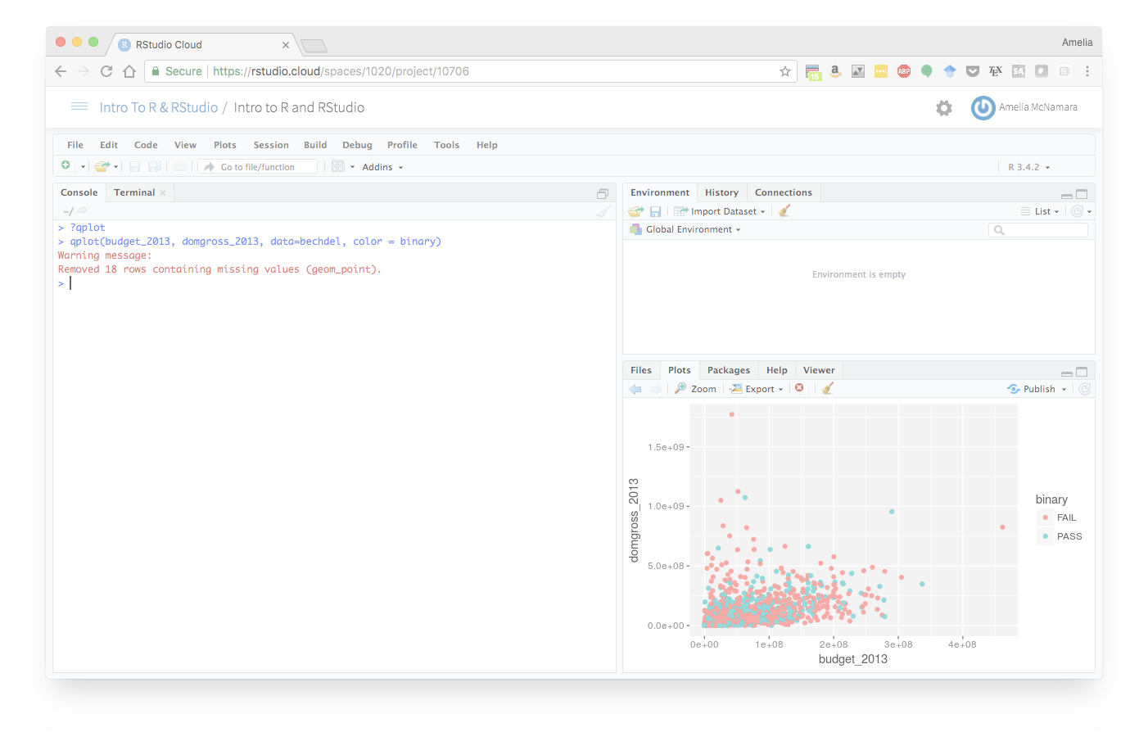
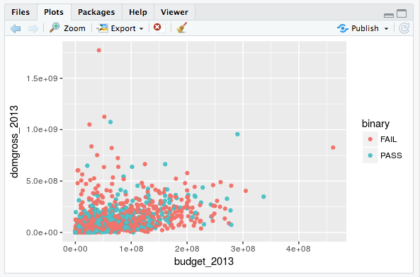
RStudio: Plots pane

Slide 21
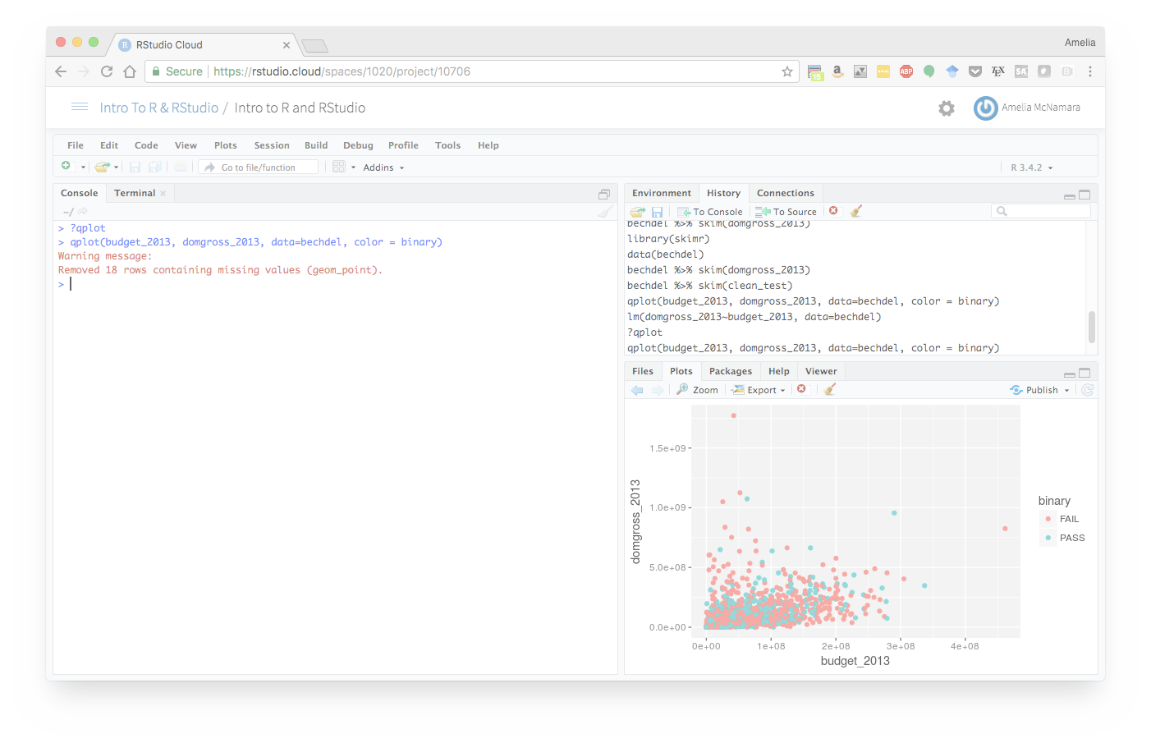
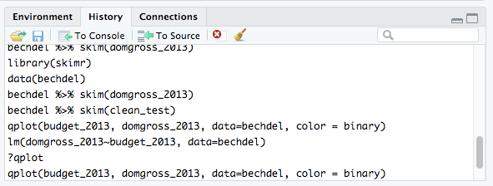
RStudio: History tab

Slide 22
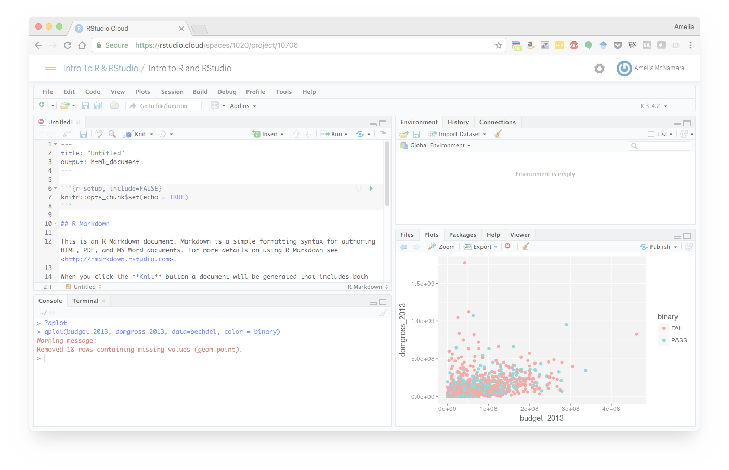
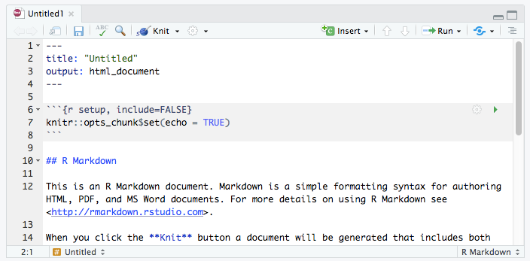
RStudio: Rmarkdown

Slide 23
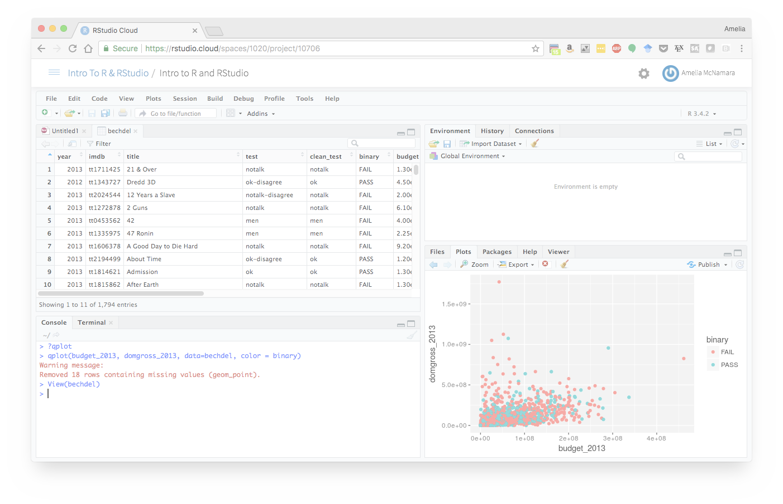
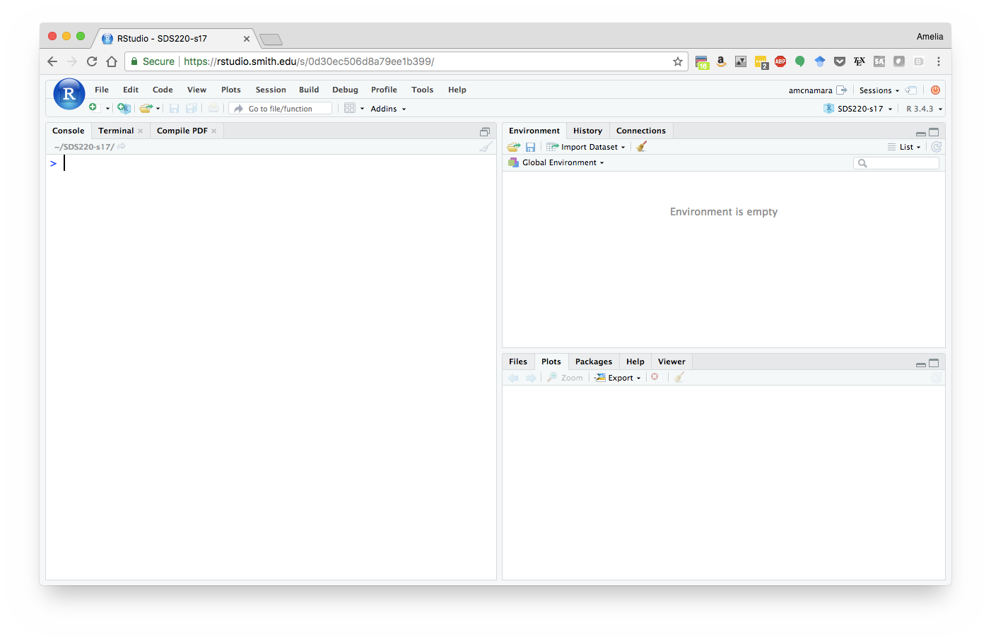
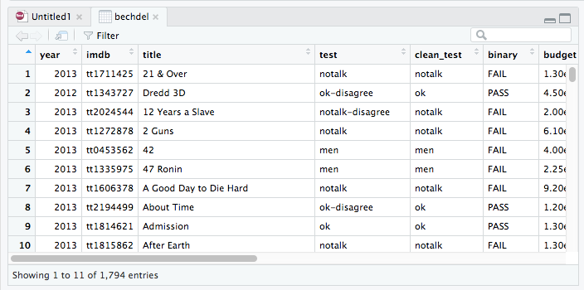
RStudio

Slide 24
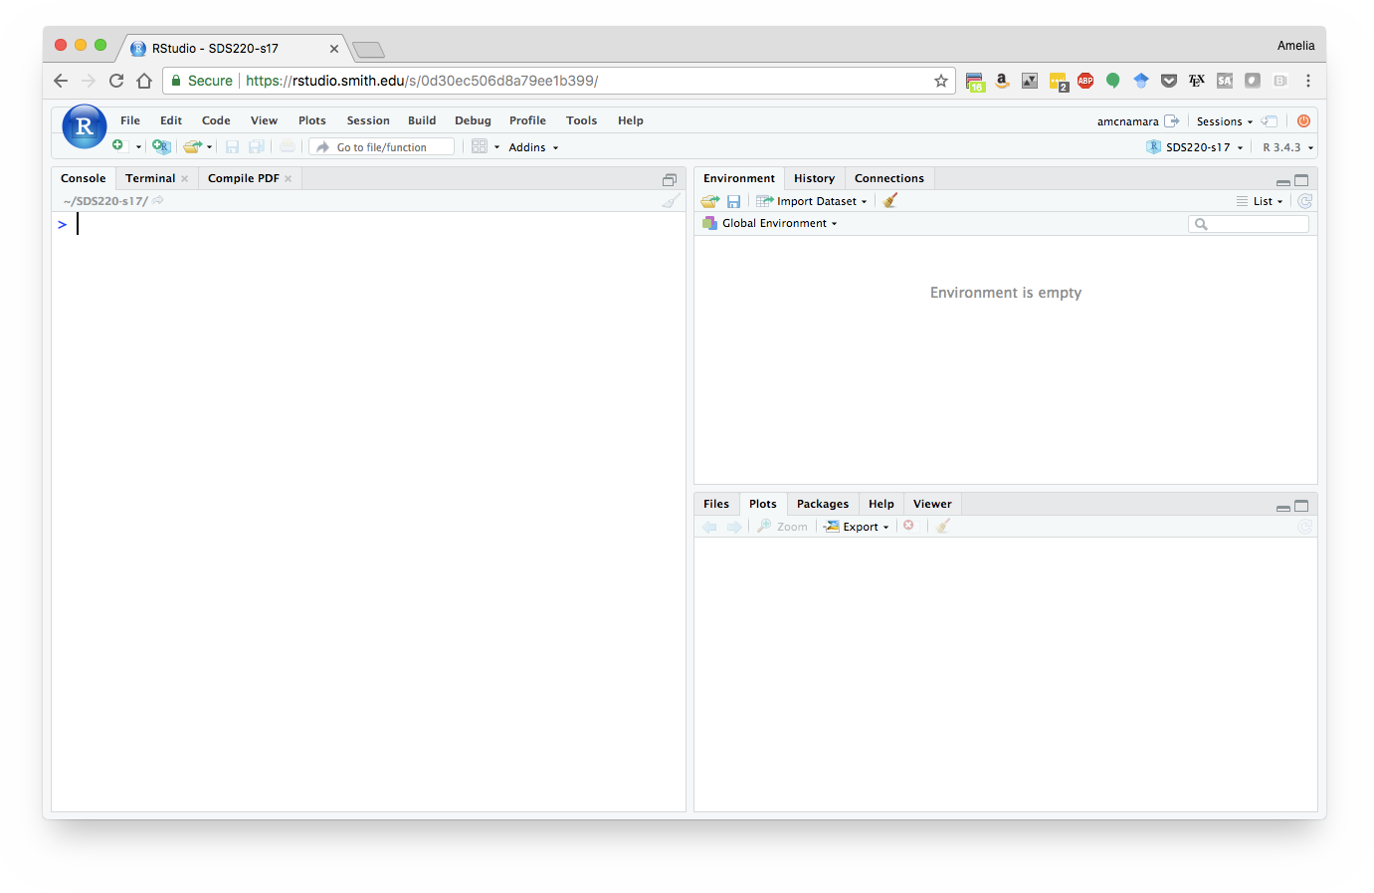
RStudio: Server
Allows you to log in through a web browser and do your work there (similar to Google docs)

Slide 25
RStudio: Server- Data Science Workbench
DSW is an Uber internal web application that lets you write, run, save, and share R and python code. It's a tool widely used across the Uber data science team to conduct and share analyses.
Follow these steps to get started with DSW:
Request access to DSW
Read through DSW's Quickstart Page
Watch the Introduction to Data Science Workbench video tutorial
Notes:
which allows you to log in through a web browser and do your work there.

Slide 26
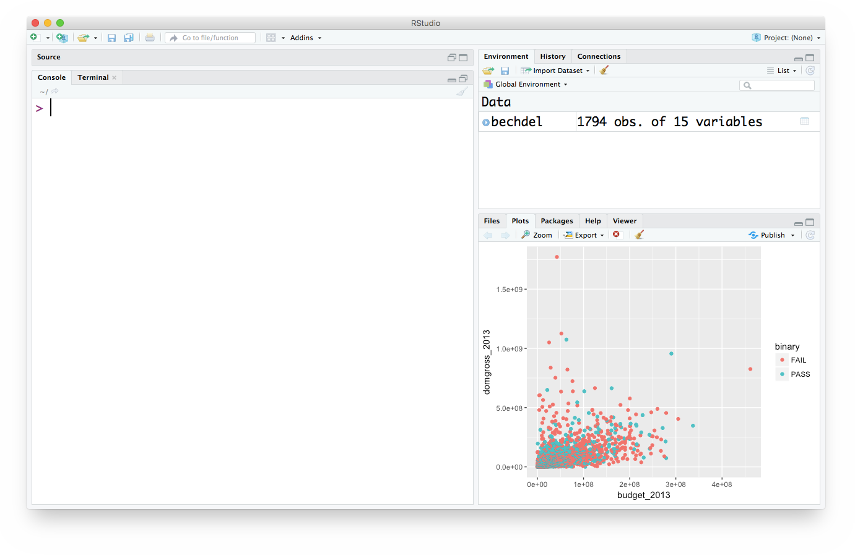
RStudio: Desktop
Work on files locally to your computer.
Con: can be hard to share/collaborate code.

Slide 27
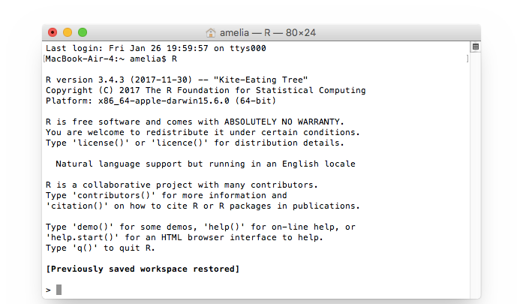
Transferability
Everything you learn here will work in any version of RStudio
It will even work in the basic console version of R

Slide 28
Tips
Learning things can be frustrating! Ask questions!
Practice! Seriously: practice!
Practice consciously:
Make a prediction, then test it, then reflect

Slide 29
Rstudio

Slide 30
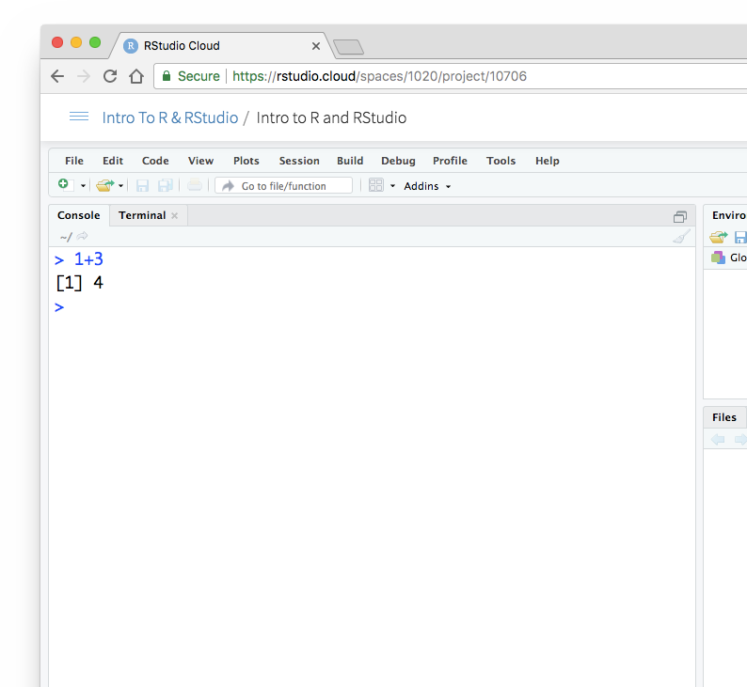
RStudio Console
The console gives you a place to execute commands written in R
Type commands on the line that begins with a > sign
(known as the prompt)

Slide 31
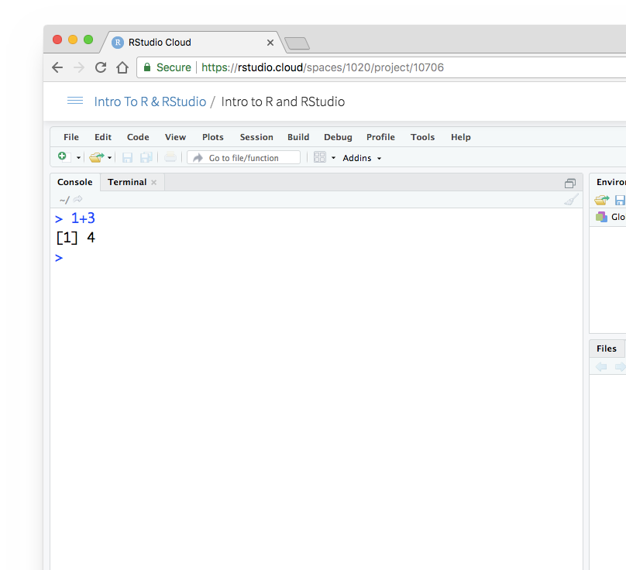


Output
When you hit enter,
RStudio will run your command and display any output below it.
Output
New prompt

Slide 32
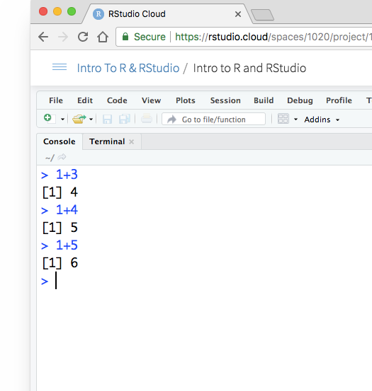


[1]
R displays an index next to the output.
Just ignore this.
Somewhat helpful when R returns more than one value in the output.

Slide 33

R as a calculator
R
Let’s run some of this code in your console:
5 + 5
4 - 1
1 * 2
4 ^ 2
Notes:
Let’s run some of this code in your console

Slide 34
R as a calculator
R
Let’s run some of this code in your console:
5 + 5
# 10
4 - 1
# 3
1 * 2
# 2
4 ^ 2
# 16
Notes:
Let’s run some of this code in your console

Slide 35
R can do Algebra
R
Let’s run some of this code in your console:
a <- 1
b <- 2
a + b
A <- 3
a + b - A

Slide 36

R can do Algebra
R
Let’s run some of this code in your console:
a <- 1
b <- 2
a + b
# 3
R cares about capitalization
A <- 3
a + b - A
# 0

Slide 37
R got tricks
R
round(3.1415)
factorial(3)
sqrt(9)

Slide 38
R got tricks
R
round(3.1415) # 3
factorial(3) # 6
3! = 3 x 2 x 1
sqrt(9) # 3
square root

Slide 39
Your turn
What do you think this will return?
factorial(round(2.0015) + 1)

Slide 40
R works from the innermost parentheses to the outermost (just like a calculator)
factorial(round(2.0015) + 1)
factorial(2 + 1)
factorial(3)
6

Slide 41
R works from the innermost parentheses to the outermost (just like a calculator)
factorial(round(2.0015) + 1)
factorial(2 + 1)
factorial(3)
6

Slide 42
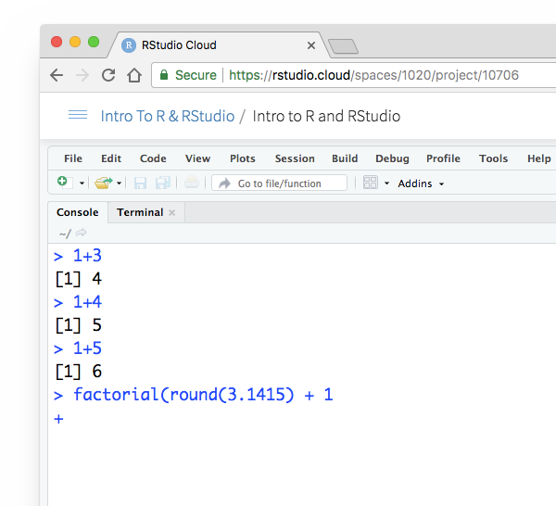

prompt
If your prompt turns into a "+", R thinks you haven't finished your previous command.
Either finish the command, or press escape.

Slide 43
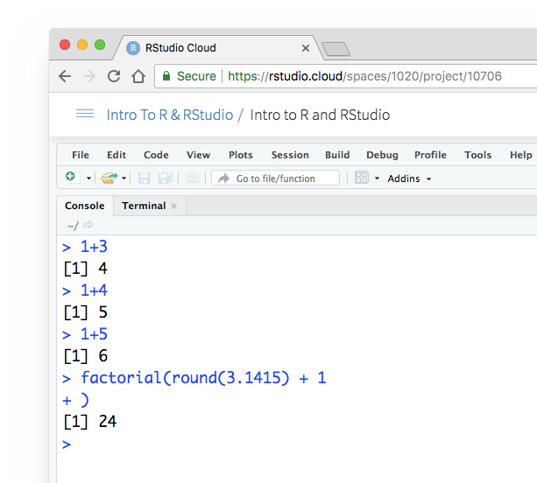
prompt
If your prompt turns into a "+", R thinks you haven't finished your previous command.
Either finish the command, or press escape.

Slide 44
Your turn
Open RStudio, click on the console, and try the following tasks:
Pick a number and add 2 to it
Multiply the result by 3
Subtract 6 from the result of step 2

Slide 45
Your turn
10 + 2
# 12
12 * 3
# 36
36 - 6
# 30
30 / 3
# 10

Slide 46
RStudio tip: Retrieving Previous Commands
Recall previous commands using the arrow keys:
Up — Recall previous command(s)
Down — Reverse of Up

Slide 47
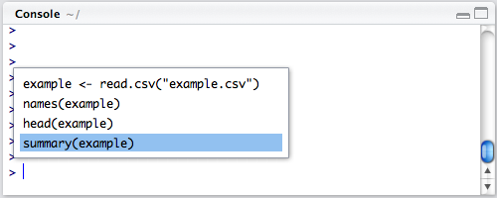
RStudio tip: Retrieving Previous Commands
To review a list of your recent commands:
Ctrl+Up (PC)
Cmd + Up (Mac)

Slide 48
R Notebooks

Slide 49
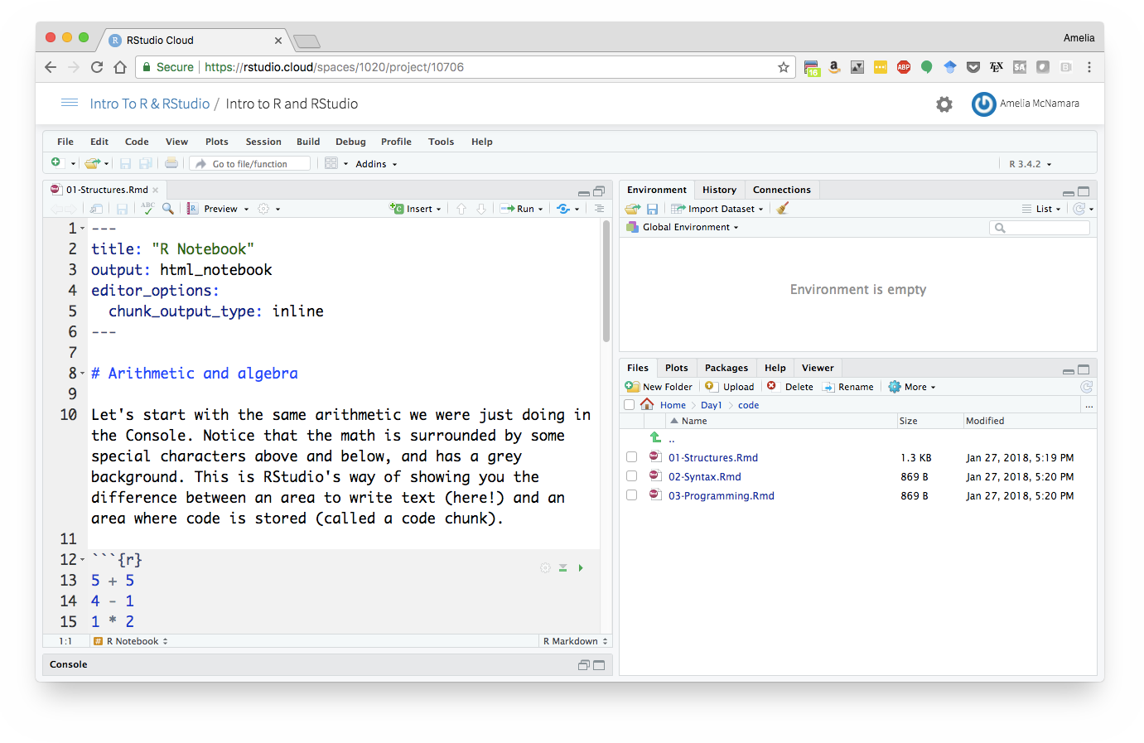
R Notebooks
It is easier to compose your code in an R Notebook than in the command line/console.
Notebooks allow you to keep text with your code.

Slide 50
Your turn
Go back to your file 01-Intro.Rmd

Slide 51

R Notebooks
Notice that the Console has automatically minimized itself to give you room to work in your notebook.
From here out, we'll be working almost exclusively in notebooks
(but all the code we write would work in the Console as well)

Slide 52
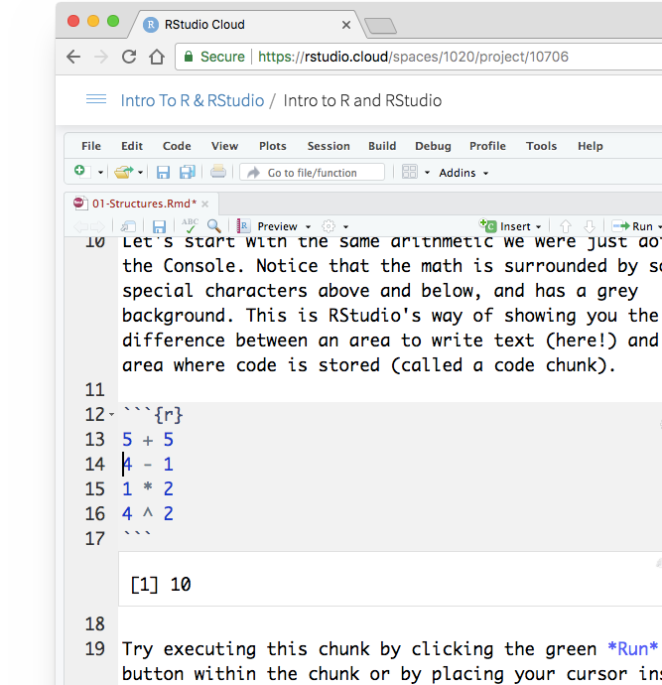
R Notebooks
Do what the text instructs, and run a line of the code.
Notice how results display immediately below the chunk, just like they did in the Console.

Slide 53
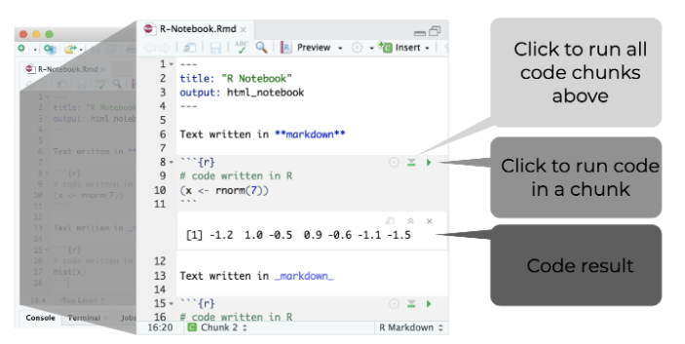
Code Chunks

Slide 54
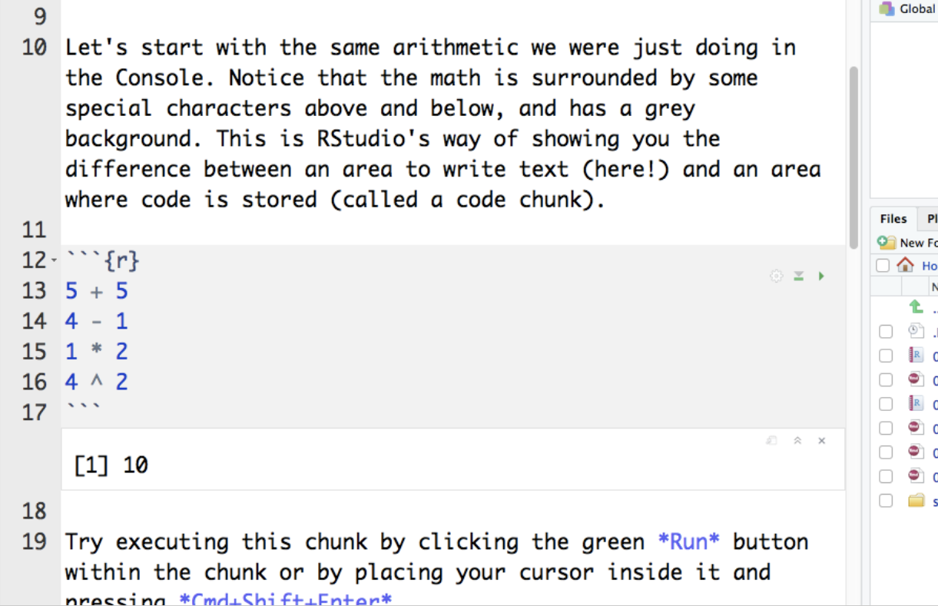
Code Chunks
Let’s start with the same arithmetic we were just doing in the Console.
Notice that the math is surrounded by some special characters above and below, and has a grey background.
This is RStudio’s way of showing you the difference between an area to write text and an area where code is stored (called a code chunk)

Slide 55
Code Chunks
You can also run just one line of code, by placing your cursor on the line and hitting Command Enter.

Slide 56
Code Chunks
You can quickly insert chunks like these into your file with:
Keyboard shortcut:
Ctrl + Alt + I (PC)
Cmd + Option + I (OS X)
Add Chunk command in the editor toolbar
Typing the chunk delimiters ```{r} and ```

Slide 57
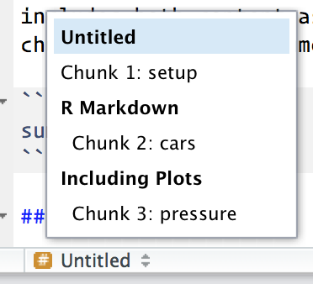
Code Chunk Names
Chunks can be given an optional name: ```{r by-name}
Chunk names have three advantages:
Navigate to specific chunks using the drop-down code navigator in the bottom-left of the script editor
Graphics produced by the chunks will have useful names that make them easier to use elsewhere.
You can set up networks of cached chunks to avoid re-performing expensive computations on every run.

Slide 58
Code Chunk Options
include = FALSE prevents code and results from appearing in the finished file. R Markdown still runs the code in the chunk, and the results can be used by other chunks.
echo = FALSE prevents code, but not the results from appearing in the finished file. This is a useful way to embed figures.
message = FALSE prevents messages that are generated by code from appearing in the finished file.
warning = FALSE prevents warnings that are generated by code from appearing in the finished.
fig.cap = "..." adds a caption to graphical results.
See the R Markdown Reference Guide a complete list of knitr chunk options.
Read more about code chunks through RStudio here or the RMarkdown Guide

Slide 59
Code Chunk Options
The following table summarises which types of output each option supressess:
Option | Run code | Show code | Output | Plots | Messages | Warnings
eval = FALSE | - |  | - | - | - | -
include = FALSE |  | - | - | - | - | -
echo = FALSE |  | -
results = "hide" |  |  | -
fig.show = "hide" |  |  |  | -
message = FALSE |  |  |  |  | -
warning = FALSE |  |  |  |  |  | -
Table from R 4 Data Science

Slide 60
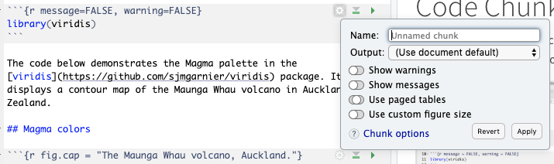
Code Chunk Options
You can also use the gear in the top right of code chunks to set custom options as well.

Slide 61
Code Chunk Global Options
To set global options that apply to every chunk in your file, call knitr::opts_chunk$set in a code chunk.
Knitr will treat each option that you pass to knitr::opts_chunk$set as a global default that can be overwritten in individual chunk headers.

Slide 62
Code Chunk Global Options
If a certain option needs to be frequently set to a value in multiple code chunks, you can consider setting it globally in the first code chunk of your document.
There is one chunk name that has special behaviour: setup
When you’re in a notebook mode, the chunk named setup will be run automatically once, before any other code is run.
```{r, setup, include=FALSE}
knitr::opts_chunk$set(fig.width = 8, collapse = TRUE)
```

Slide 63
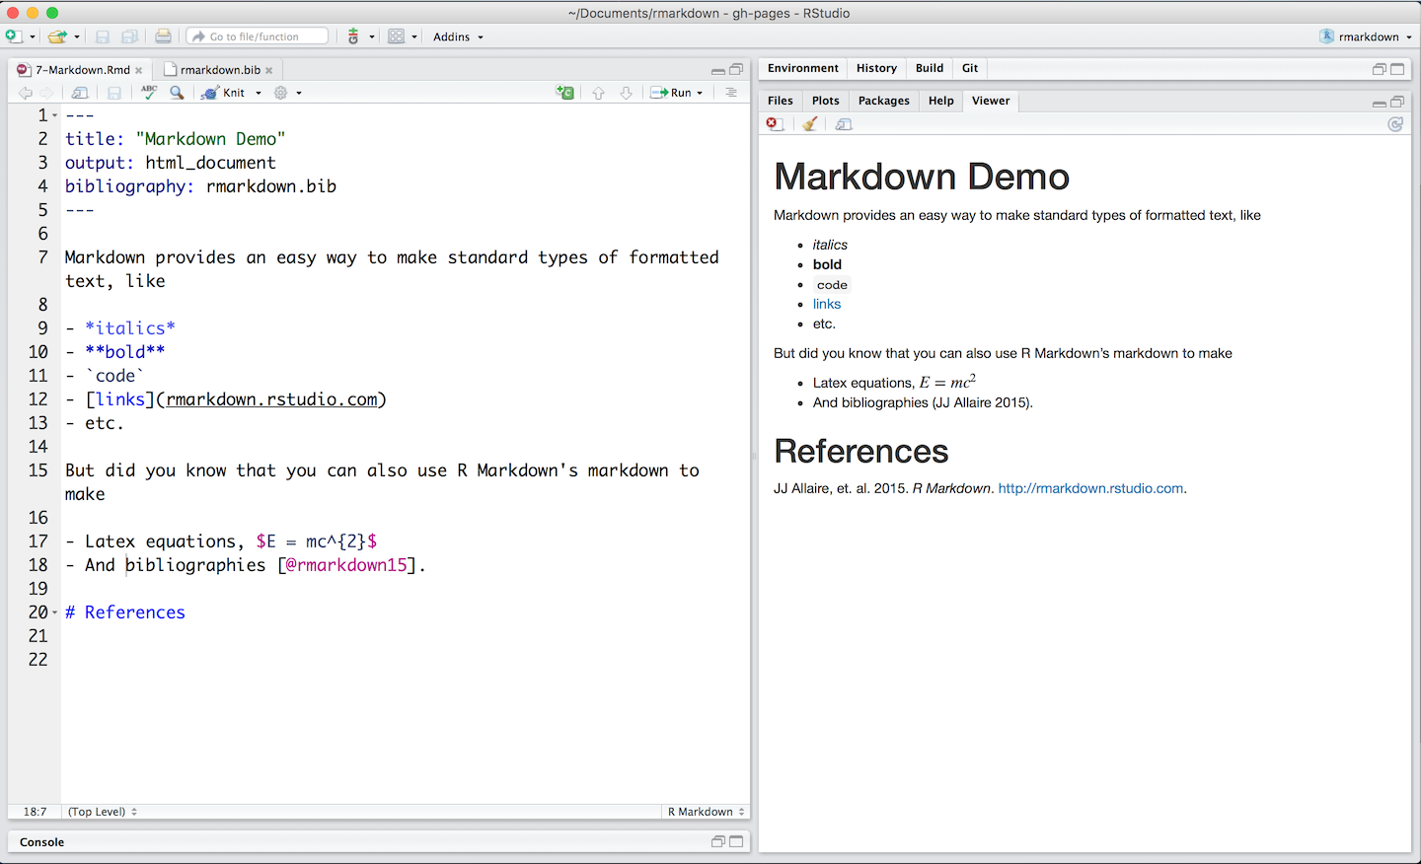
R Markdown

Slide 64
R Markdown
Use the white space between code chunks to write formatted text in Markdown.
When you render your file, Pandoc transforms the marked up text into formatted text in your final file format.
RMarkdown cheat sheet available in RStudio via Help → Cheat sheets → RMarkdown cheat sheet
Read more about markdown at Pandoc’s Markdown or consult the quick reference in the R Markdown Cheatsheet.
Pandoc’s Markdown can make:
Headers
Lists
Links
Images
Block quotes
Latex equations
Horizontal rules
Tables
Footnotes
Bibliographies and Citations
Slide breaks
Italicized text
Bold text
Superscripts
Subscripts
Strikethrough text

Slide 65
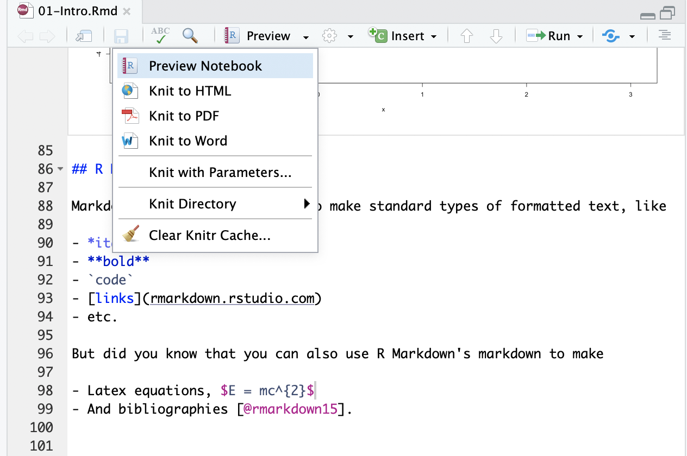
R Notebook Preview
While you're working, you can view your notebook by clicking "Preview."

Slide 66
Your turn
Place your cursor by the section ## R Markdown text in the 01-Intro file.Rmd
Select “Preview” > “Preview Notebook”
Observe the formatted text in the R Markdown section

Slide 67
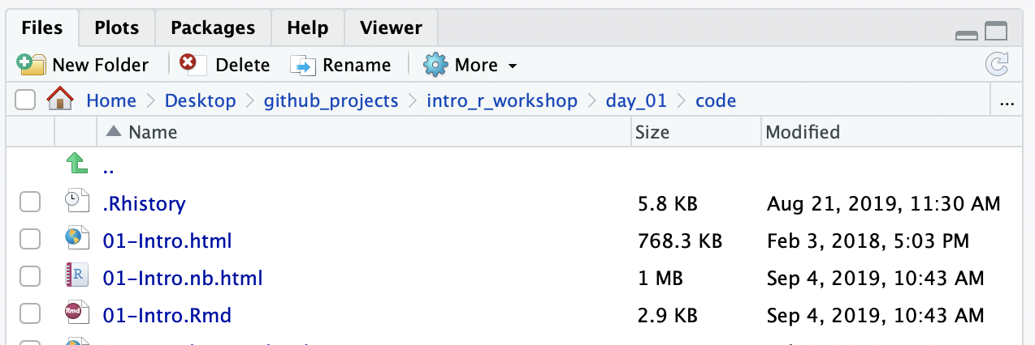
Sharing your work
The Preview is something only available to you, but RStudio automatically creates a file you can share with others when you save an R Notebook.
The file it creates is an HTML file, and it has a name that corresponds to your Rmd

Slide 68
Recap: R vs. RStudio vs. R Markdown
R is a programming language (e.g. Python)
RStudio is an application to run R code.
Markdown is a markup syntax (e.g. HTML)
R Markdown is Markdown plus the ability to render R chunks

Slide 69
R Packages

Slide 70








help
help
help
function1() function2() function3() function4()

Slide 71








help
help
help
help
help
help
help
help
help
help
help
help
function1() function2() function3() function4()
function5() function6() function7() function8()
function9() functionA() functionB() functionC()
functionD() functionE() functionF() functionG()
Base R

Slide 72










help help help
function1() function2() function3() function4()
help
help
help
help
help
help
help
help
help
function5() function6() function7() function8()
function9() functionA() functionB() functionC()
functionD() functionE() functionF() functionG()
Base R
R Packages

Slide 73
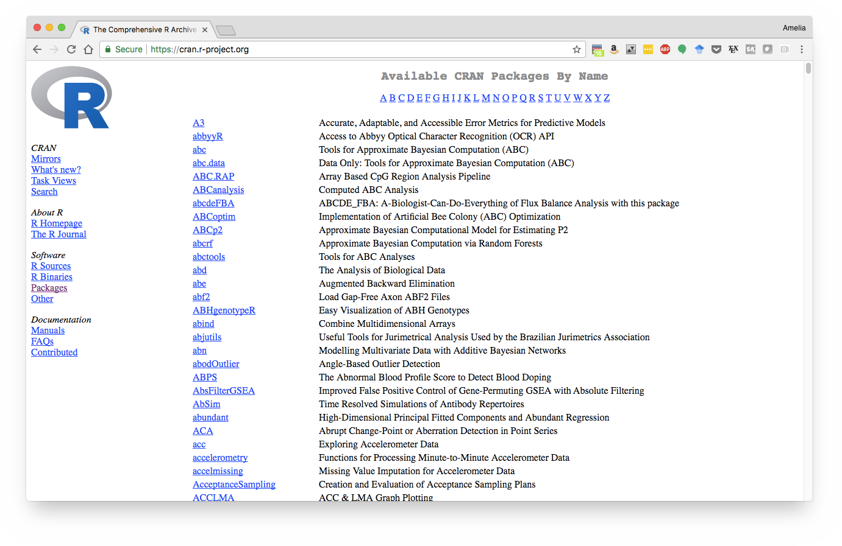

Slide 74
Using packages
1.
2.
install.packages("ggplot2")
library(ggplot2)
Downloads files to computer
1 x per computer
Loads package
1 x per R Session
Notes:
You install them from CRAN with install.packages("x").
You use them in R with library("x").
You get help on them with package?x and help(package = "x")

Slide 75
The tidyverse

Slide 76
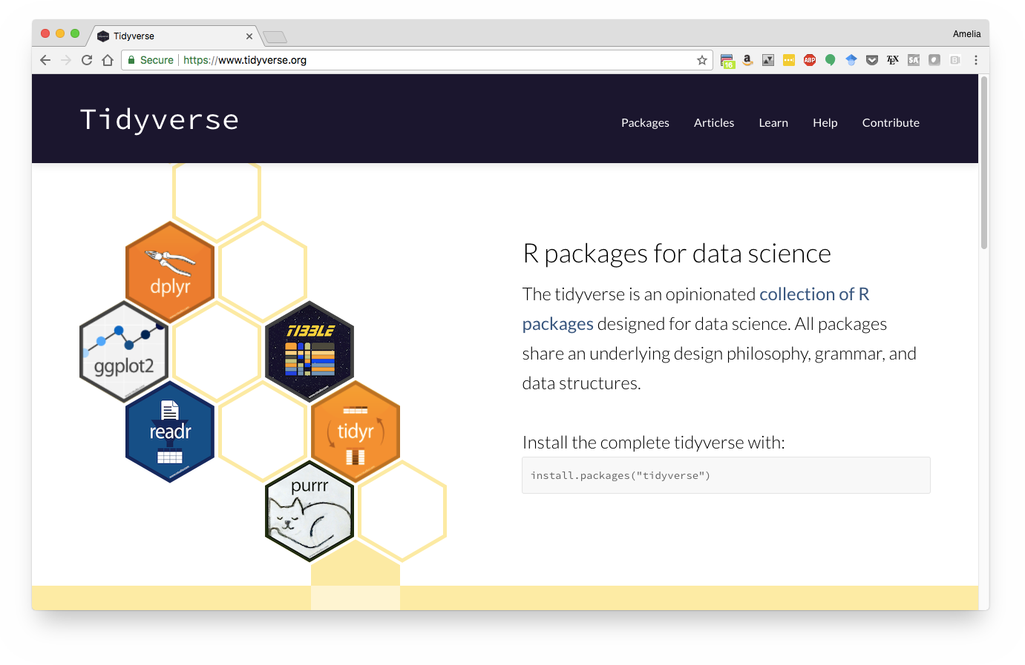

Slide 77

The tidyverse is an opinionated collection of R packages designed for data science.

Slide 78
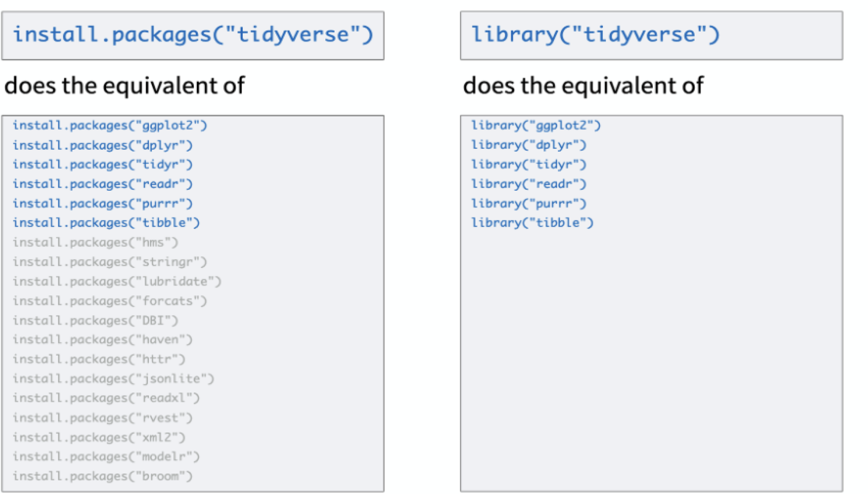
Tidyverse
The tidyverse R package serves as a shortcut for installing and loading the components of the tidyverse.

Slide 79
Tidy data
A data set is tidy if:
Each variable forms a column
Each observation forms a row
Each type of observational unit forms a table
From tidyr.tidyverse.com

Slide 80
Messy data
Common attributes of messy data:
Column headers are values, not variable names
Multiple variables are stored in one column
Variables are stored in both rows and columns
Multiple types of observational units are stored in the same table
A single observational unit is stored in multiple tables.
From tidyr.tidyverse.com

Slide 81
They do one thing, and they do it well
Top tidyverse functions
filter() extract observations
arrange() reorder observations
group_by() group observations
select() extract variables
mutate() create new variables
summarise() summarise variables / create observations

Slide 82
They do one thing, and they do it well
Top tidyverse functions
gather() Move column names into values (“wide” to long)
left_join() Merge two tables, keep all rows from the left table
ggplot() Create data visualizations
read_csv() Load data into R
write_csv() Save files to export from R

Slide 83
Data types
02
Back to Agenda

Slide 84
R Objects

Slide 85
R Objects
You can save information as an R object with the greater than sign followed by a minus,
e.g, an arrow: <-

Slide 86
R Objects
You can save information as an R object with the greater than sign followed by a minus,
e.g, an arrow: <-
the_answer <- 42

Slide 87
R Objects
name of new object
the_answer <- 42

Slide 88
R Objects
assignment operator, "gets"
the_answer <- 42

Slide 89
R Objects
information to store in the object
the_answer <- 42

Slide 90
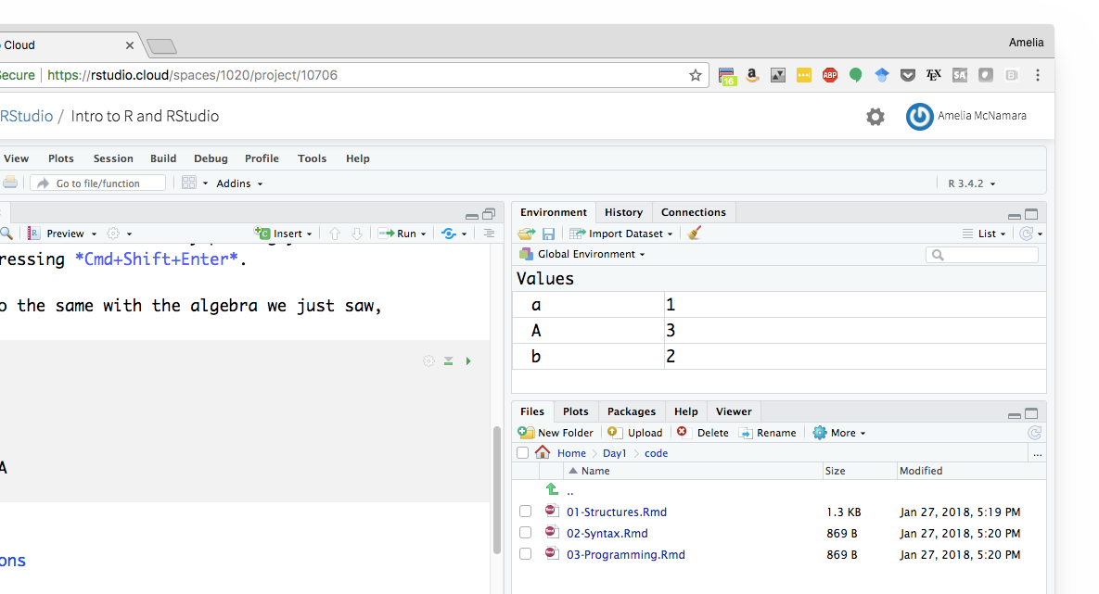

R Objects
What objects are in your environment right now?
When you create an R object, you'll see it appear in your environment pane

Slide 91
Common R workflow
Save the output of one function as an R object to use in a second function.
more_pi <- round(3.1415) + 1
more_pi
# 4
factorial(more_pi)
# 24

Slide 92
When creating object names…
Do’s
Dont’s
Lowercase
Use an underscore (_) to separate words within a name
Variable names should be nouns, function names should be verbs.
Concise
Meaningful/informative
Cannot begin with numbers
Cannot contain spaces
Avoid names already in use
Are not generic
Read more on Hadley’s Style Guide

Slide 93
Sample object names
Bad names | OK names | Great names
2nd | a | cdc_data
mean | b | final _model
data | FOO | more_pi
!bad | my_var | without_over_64

Slide 94
Capitalization matters
R will treat each of these as a diﬀerent object
cdc_data finalmodel sum
CDC_data finalModel SUM

Slide 95
rm
You can remove an object from your environment with rm
more_pi
# 4
rm(more_pi)
more_pi
# Error: object ‘more_pi' not found

Slide 96
rm
This can be useful if you overwrite an object that comes with R
pi
# 3.141593
pi <- 1
pi
# 1
rm(pi)
pi
# 3.141593

Slide 97
vectors

Slide 98
Vectors
Combine multiple elements into a one dimensional array.
Create vectors with the c function
(for "concatenate").
vec <- c(1, 2, 3, 10, 100)
vec

Slide 99
Your turn
What happens in your Environment when you run this code?
In your Notebook?
vec <- c(1, 2, 3, 10, 100)
vec

Slide 100
Data types

Slide 101
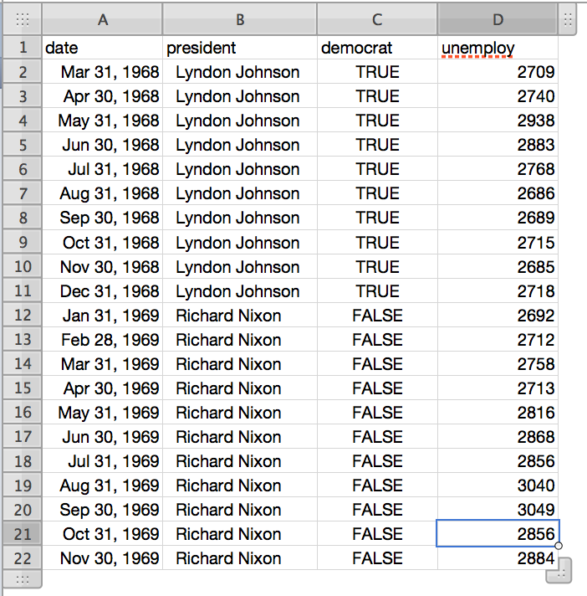
Warm up
What types of data are in this spreadsheet?

Slide 102
Data types
Like Excel, R can recognize diﬀerent types of data.
We'll look at four basic data types:
numbers
character strings (text)
logical
factor

Slide 103
Data type: Numeric
Any number, no quotes.
Appropriate for math.
1 + 1
3000000
class(0.00001)
# "numeric"

Slide 104
Data type: Character
Any symbols surrounded by quotes.
Appropriate for words, variable names, messages, any text.
"hello"
class("hello")
# "character"

Slide 105
"hello" + "world"
# Error
nchar("hello")
# 5
paste("hello", "world")
# "hello world"

Slide 106
Your turn
Which of these are numbers?
What are the others?
How can you tell?
1
“1”
“one”

Slide 107
Data type: Logical
TRUE or FALSE
R's form of binary data. Useful for logical tests.
3 < 4
# TRUE
class(TRUE)
# "logical"
class(T)
# "logical"

Slide 108
Data type: Factor
R's form of categorical data. Saved as an integer with a set of labels (e.g. levels).
Factors are important when including categorical variables in regression models and plotting data
fac <- factor(c("a", "b", "c")) fac
# a b c
# Levels: a b c
class(fac)
# factor

Slide 109
Basic data types
Type | Examples
numeric | 0, 1, -2, 3.1415, 0.0005
character | "Amelia", "Agree", "31"
logical | TRUE, FALSE
factor | a c c b Levels: a b c

Slide 110
Quiz
Run: x <- c(1, 2, 3)
What is the diﬀerence between these?
X vs. “X”

Slide 111
Your turn
Make a vector that contains:
the number 1,
the letter R,
and the logical TRUE.
What class of data is the vector?

Slide 112
What is R doing?
vec <- c(1, "R", TRUE)
class(vec)
# "character"
vec
# "1" "R" "TRUE"

Slide 113
Your turn
Another way to see the class of an object is in the Environment pane.
Does the Environment agree with what you found using class()?

Slide 114
Coercion

Slide 115







Coercion
numeric
True
1
False
0
logical
character

Slide 116
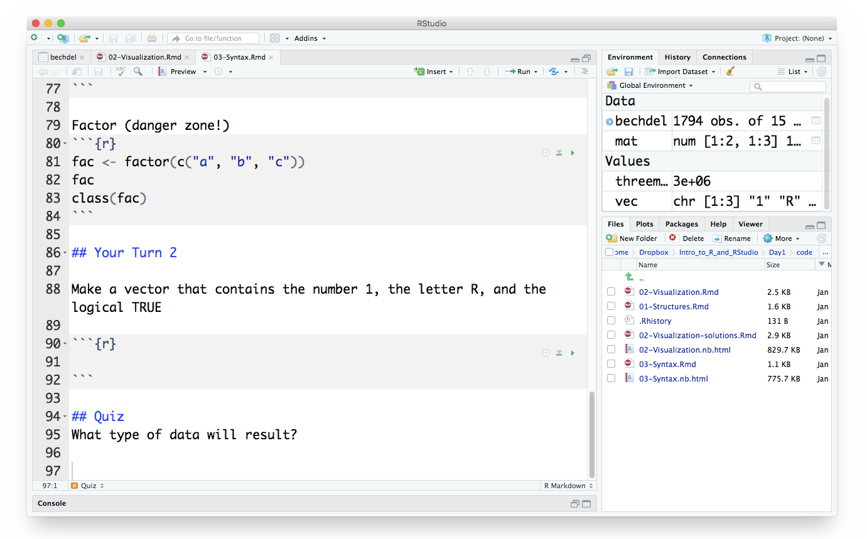

Use the Insert button or cmd + opt + i to insert a chunk.

Slide 117
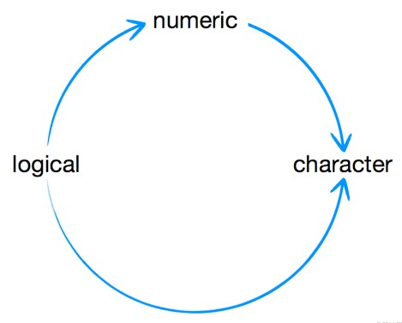
Quiz
What type of data will result?
c(5, "two")
c(TRUE, "a")
c(1, "TRUE")
TRUE + 5

Slide 118
Quiz
What type of data will result?
c(5, "two")
c(TRUE, "a")
c(1, "TRUE")
TRUE + 5
#character
#character
#character
#numeric

Slide 119
Manual coercion
function | coerces data to
as.numeric | numeric
as.character | character
as.logical | logical
as.factor | factor

Slide 120
Manual coercion
Try the code below
as.numeric("1")
as.character(TRUE)

Slide 121
Data frames

Slide 122
Data frame ~ Data table
A data frame is a two dimensional group of R objects.
Each column in a data frame can be a diﬀerent data type.
A data frame has:
Variables of a data set as columns
Observations as rows.
df <- data.frame(c(1, 2, 3),
c("R","S","T"),
c(TRUE, FALSE, TRUE))
class(df)
# "data.frame"

Slide 123
str()
Run str() to see the structure of an object
TRUE
FALSE
TRUE
1
"R"
"S"
"T"
df <- data.frame(c(1, 2, 3),
c("R","S","T"),
c(TRUE, FALSE, TRUE))
class(df)
str(df)
2
3
numeric
factor
logical

Slide 124
Names
You can name the elements of a vector, list, or data frame when you create them.
nvec <- c(one = 1,
two = 2,
three = 3)
nvec
# one two three
1 2 3

Slide 125
ndf <- data.frame(numbers = c(1, 2, 3),
letters = c("R","S","T"),
logic = c(TRUE, FALSE, TRUE))
ndf
# numbers letters logic
1
2
3
R
S
T
TRUE
FALSE
TRUE

Slide 126
Your turn
Use the RStudio data preview to compare df and ndf

Slide 127
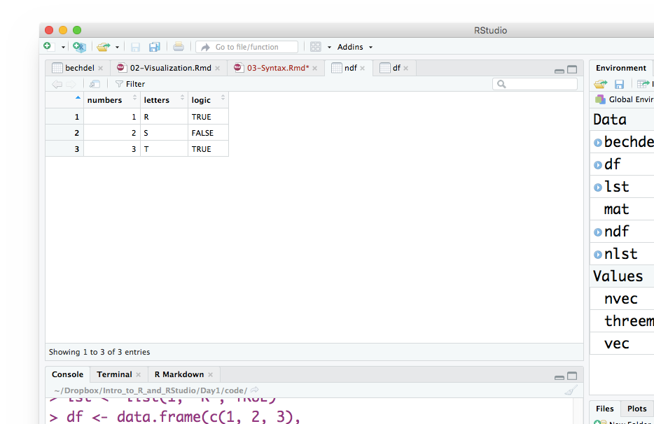

Slide 128
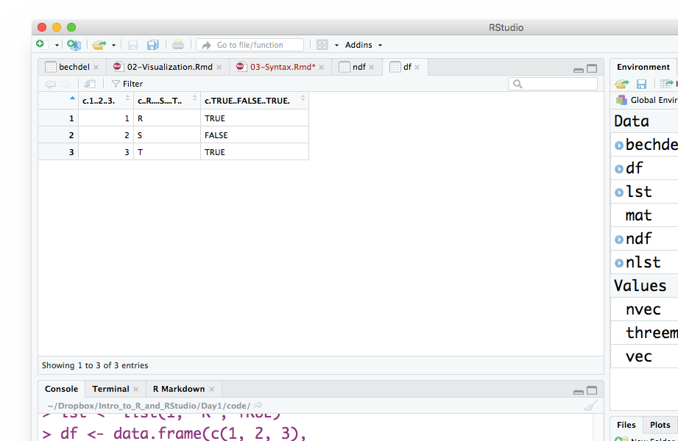
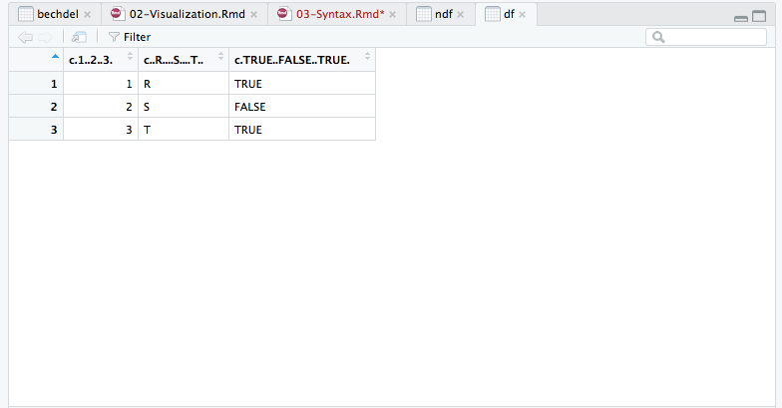

Slide 129
You can also see the names with names
names(ndf)
# [1] "numbers" "letters" "logic"
names(nvec)
# [1] "one" "two" "three"

Slide 130
Tibble

Slide 131
Tibbles: Simple data frames
Tibbles are data frames…
… But they have some characteristics that make life a little easier than using data frames.
Almost all of the functions that you’ll use in the tidyverse produce tibbles.
Most other R packages use regular data frames,
so you might want to coerce a data frame to a tibble. You can do that with as_tibble()

Slide 132
tibble
Notice how the second character is stored
TRUE
FALSE
TRUE
1
"R"
"S"
"T"
df_tibble <- tibble(c(1, 2, 3),
c("R","S","T"),
c(TRUE, FALSE,TRUE))
str(df_tibble)
2
3
numeric
character
logical

Slide 133
Subsetting and transformation
03
Back to Agenda

Slide 134
Transform
From R for Data Science by Hadley Wickham and Garrett Grolemund.

Slide 135
Create toy data (as a data frame)
#Data frame
beatles <- data.frame(name = c("John", "Paul", "George", "Ringo"),
birth = c(1940, 1942, 1943, 1940),
instrument = c("guitar", "bass", "guitar", "drums")
)

Slide 136
Create toy data (as a tibble)
#Tibble
beatles_tibble1 <- tibble(name = c("John", "Paul", "George", "Ringo"),
birth = c(1940, 1942, 1943, 1940),
instrument = c("guitar", "bass", "guitar", "drums")
)
#Tibble v2
beatles_tibble2 <- tribble(~name, ~birth, ~instrument,
#------|-------|------------
"John", 1940, "guitar",
"Paul", 1942, "bass",
"George", 1943, "guitar",
"Ringo", 1940, "drums"
)

Slide 137
Subsetting via dplyr

Slide 138
dplyr methods for isolating data
select() - extract variables
filter() - extract observations
arrange() - reorder observations

Slide 139

select()
Extract columns by name.
select(.data, …)
data frame to transform
name(s) of columns to extract
(or a select helper function)

Slide 140
select()
Extract columns by name.
select(beatles, name, birth)
beatles
name | birth | instrument
John | 1940 | guitar
Paul | 1942 | base
George | 1943 | guitar
Ringo | 1940 | drums
name | birth
John | 1940
Paul | 1942
George | 1943
Ringo | 1940

Slide 141
Your Turn
Alter the code to select just the instrument column:
select(beatles, name, birth)

Slide 142
Your Turn
Alter the code to select just the instrument column:
select(beatles, instrument)

Slide 143
select() helpers
: Select range of columns
select(storms, storm:pressure)
Select every column EXCEPT
select(storms, -c(storm, pressure))
starts_with() Select columns that start with…
select(storms, starts_with("w"))
ends_with() Select columns that end with…
select(storms, ends_with("e"))

Slide 144
select() helpers
contains() - Select columns whose names contain…
select(storms, contains("d"))
matches() - Select columns whose names match regular expression
select(storms, matches("^.{4}$"))
one_of() - Select columns whose names are one of a set
select(storms, one_of(c("storm", "storms", "Storm"))
num_range() - Select columns named in prefix, number style
select(storms, num_range("x", 1:5))

Slide 145
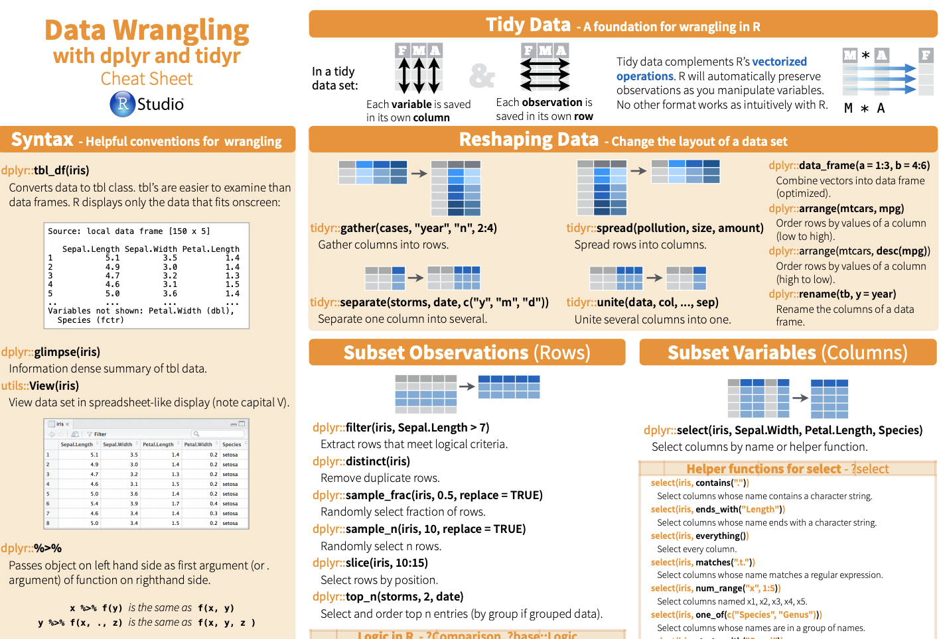
select() helpers
View more tips on select() helpers on the Data Wrangling Cheat Sheet

Slide 146
Common syntax
Each function takes a data frame/tibble as its first argument and returns a data frame/tibble.
filter(.data, … )
function specific arguments
data frame to transform
dplyr function

Slide 147
filter()
Extract rows that meet logical criteria.
filter(.data, … )
data frame to transform
one or more logical tests (filter returns each row for which the test is TRUE)

Slide 148
filter()
Extract rows that meet logical criteria.
filter(beatles, name == "George")
beatles
name | birth | instrument
John | 1940 | guitar
Paul | 1942 | base
George | 1943 | guitar
Ringo | 1940 | drums
George | 1943 | guitar

Slide 149
filter()
Extract rows that meet logical criteria
filter(beatles, name == "George")
beatles
= sets (returns nothing)
== tests if equal (returns TRUE or FALSE)
name | birth | instrument
John | 1940 | guitar
Paul | 1942 | base
George | 1943 | guitar
Ringo | 1940 | drums

Slide 150
Your turn
Alter the code to filter out just rows where birth is 1940:
filter(beatles, name == "George")

Slide 151
Logical comparisons

Slide 152


Logical comparisons
?Comparison
x < y | Less than
x > y | Greater than
x == y | Equal to
x <= y | Less than or equal to
x >= y | Greater than or equal to
x != y | Not equal to
x %in% y | Group membership
is.na(x) | Is NA (is null/is missing)
!is.na(x) | Is not NA (is not null/missing)
base R

Slide 153
Logical comparisons
What will these return?
1 < 3
1 > 3
c(1, 2, 3, 4, 5) > 3
base R

Slide 154
%in%
What does this do?
1 %in% c(1, 2, 3, 4)
1 %in% c(2, 3, 4)
c(3,4,5,6) %in% c(2, 3, 4)
base R

Slide 155
%in%
%in% tests whether the object on the left is a member of the group on the right.
base
R
1 %in% c(1, 2, 3, 4)
#TRUE
1 %in% c(2, 3, 4)
#FALSE
c(3,4,5,6) %in% c(2, 3, 4)
# TRUE TRUE FALSE FALSE
base R

Slide 156
Your turn
Run this code, then run all the operators:
x <- c(1, 2, 3, 4, 5)
Operator | Result | Comparison
x > 3 | c(F, F, F, T, T) | greater than
x >= 3
x < 3
x <= 3
x == 3
x != 3
x = 3

Slide 157
Your turn
x <- c(1, 2, 3, 4, 5)
Operator | Result | Comparison
x > 3 | c(F, F, F, T, T) | greater than
x >= 3 | c(F, F, T, T, T) | greater than or equal to
x < 3 | c(T, T, F, F, F) | less than
x <= 3 | c(T, T, T, F, F) | less than or equal to
x == 3 | c(F, F, T, F, F) | equal to
x != 3 | c(T, T, F, T, T) | not equal to
x = 3 |  | same as <-

Slide 158
Boolean operators

Slide 159
Boolean operators
?base::Logic
a & b | and
a | b | or
xor(a,b) | exactly or
!a | not
base R

Slide 160
Boolean operators
You can combine logical tests with &, |, xor, !, any, and all
x > 2 & x < 9
base R

Slide 161
Boolean operators
You can combine logical tests with &, |, xor, !, any, and all
x > 2 & x < 9
TRUE &
base R

Slide 162
Boolean operators
You can combine logical tests with &, |, xor, !, any, and all
x > 2 & x < 9
TRUE & TRUE
base R

Slide 163
Boolean operators
You can combine logical tests with &, |, xor, !, any, and all
x > 2 & x < 9
TRUE & TRUE
TRUE
base R

Slide 164
&
Are both condition 1 and condition 2 true?
expression | outcome
TRUE & TRUE | TRUE
TRUE & FALSE | FALSE
FALSE & TRUE | FALSE
FALSE & FALSE | FALSE
base R

Slide 165
|
Is either condition 1 or condition 2 true?
expression | outcome
TRUE | TRUE | TRUE
TRUE | FALSE | TRUE
FALSE | TRUE | TRUE
FALSE | FALSE | FALSE
base R

Slide 166
xor
Is either condition 1 or condition 2 true, but not both?
expression | outcome
xor(TRUE, TRUE) | FALSE
xor( TRUE, FALSE) | TRUE
xor( FALSE, TRUE) | TRUE
xor( FALSE, FALSE) | FALSE
base R

Slide 167
!
Negation
expression | outcome
!(TRUE) | FALSE
!(FALSE) | TRUE
base R

Slide 168
filter()
Extract rows that meet every logical criteria.
filter(beatles, birth==1940, instrument == "guitar")
beatles
name | birth | instrument
John | 1940 | guitar
Paul | 1942 | base
George | 1943 | guitar
Ringo | 1940 | drums
John | 1940 | guitar

Slide 169
filter()
Extract rows that meet every logical criteria.
filter(beatles, birth==1940 & instrument == "guitar")
beatles
name | birth | instrument
John | 1940 | guitar
Paul | 1942 | base
George | 1943 | guitar
Ringo | 1940 | drums
John | 1940 | guitar

Slide 170
Your turn
Modify the code below to filter out the rows for which birth is 1943 OR instrument is drums
filter(beatles, birth==1940 & instrument == "guitar")

Slide 171
Your turn
Modify the code below to filter out the rows for which birth is 1943 OR instrument is drums
filter(beatles, birth==1940 | instrument == "guitar")

Slide 172
More filtering examples

Slide 173

Your turn
We'll play with the babynames dataset in R.
It comes in its own package, so you will need to:
Load the package
View the data

Slide 174
Your turn
We'll play with the babynames dataset in R.
It comes in its own package, so you will need to:
Load the package
View the data
library(babynames
View(babynames)

Slide 175
Your turn
Use filter and/or select to return only the babies with your first name.
(If you have a name with less than 5 occurrences in the US in any year, pick a neighbor's name.)

Slide 176
Your turn
See if you can use the logical operators to show:
All of the names where prop is greater than or equal to 0.08
All of the children named “Sea”
All of the names that have a missing value for n
(Hint: this should return an empty data set).

Slide 177
filter(babynames, prop >= 0.08)
# |  | year | sex | name | n | prop
# | 1 | 1880 | M | John | 9655 | 0.08154630
# | 2 | 1880 | M | William | 9531 | 0.08049899
# | 3 | 1881 | M | John | 8769 | 0.08098299
filter(babynames, name == "Sea")
# |  | year | sex | name | n | prop
# | 1 | 1982 | F | Sea | 5 | 2.756771e-06
# | 2 | 1985 | M | Sea | 6 | 3.119547e-06
# | 3 | 1986 | M | Sea | 5 | 2.603512e-06
# | 4 | 1998 | F | Sea | 5 | 2.580377e-06
filter(babynames, is.na(n))
# 0 rows

Slide 178
Two common mistakes
1. Using = instead of ==
filter(babynames, name = "Sea")
filter(babynames, name == "Sea")
2. Forgetting quotes
filter(babynames, | name | == | Sea)
filter(babynames, | name | == | "Sea")

Slide 179
Your turn
Use Boolean operators to alter the code below to return only the rows that contain:
Girls named Sea
Names that were used by exactly 5 or 6 children in 1880
Names that are one of Acura, Lexus, or Yugo
filter(babynames, name == "Sea" | name == "Anemone")

Slide 180
filter(babynames, name == "Sea", sex == "F")
# |  | year | sex | name | n | prop
# | 1 | 1982 | F | Sea | 5 | 2.756771e-06
# | 2 | 1998 | F | Sea | 5 | 2.580377e-06
filter(babynames, n == 5 | n == 6, year == 1880)
# year sex name # 1 1880 F Abby
# 2 1880 F Aileen
# … … … …
n prop
6 6.147289e-05
6 6.147289e-05
… …
filter(babynames, name %in% c("Acura", "Lexus", "Yugo"))
# | year | sex | name | n | prop
# 1 | 1990 | F | Lexus | 36 | 1.752932e-05
# 2 | 1990 | M | Lexus | 12 | 5.579156e-06
# … | … | … | … | … | …

Slide 181
Two MORE common mistakes
Collapsing multiple tests into one
filter(babynames, 10 < n < 20)
filter(babynames, 10 < n, n < 20)
Stringing together many tests (when you could use %in%)
filter(babynames, n == 5 | n == 6 | n == 7 | n == 8)
filter(babynames, n %in% c(5, 6, 7, 8))

Slide 182
Saving results

Slide 183
Saving results
Print to screen
filter(babynames, name %in% c("Acura", "Lexus", "Yugo"))
# | year | sex | name | n | prop
# 1 | 1990 | F | Lexus | 36 | 1.752932e-05
# 2 | 1990 | M | Lexus | 12 | 5.579156e-06
# … | … | … | … | … | …
Save to new data frame (where does this appear?)
carnames <- filter(babynames, name %in% c("Acura", "Lexus", "Yugo"))
Save over existing data frame (dangerous!)
babynames <- filter(babynames, name %in% c("Acura", "Lexus", "Yugo"))

Slide 184
Uh oh…
babynames <- filter(babynames, name %in% c("Acura", "Lexus", "Yugo"))
rm(babynames) str(babynames)
Phew!

Slide 185
%>%

Slide 186

%>%
pronounced: “pipe”

Slide 187
Steps
Filter babynames to just boys born in 2015
Select the name and n columns from the result
Arrange those columns so that the most popular names appear near the top.
boys_2015 <- filter(babynames,
year == 2015,
sex == "M")
boys_2015 <- select(boys_2015, name, n)
boys_2015 <- arrange(boys_2015, desc(n))
boys_2015

Slide 188
Steps
Filter babynames to just boys born in 2015
Select the name and n columns from the result
Arrange those columns so that the most popular names appear near the top.
boys_2015 <- filter(babynames,
year == 2015,
sex == "M")
boys_2015 <- select(boys_2015, name, n)
boys_2015 <- arrange(boys_2015, desc(n))
boys_2015

Slide 189
Steps
arrange(select(filter(babynames, year == 2015,sex =="M"),
name, n),
desc(n))

Slide 190
%>% The pipe operator
%>% passes the result on the left into the first argument of the function on right.
babynames %>% filter( , n == 98680)

Slide 191
%>% The pipe operator
These two lines of code do the same thing.
Try it.
filter(babynames, n == 99680)
babynames %>% filter(n == 99680)

Slide 192
%>% The pipe operator
These two blocks of code do the same thing.
Try it.
boys_2015 <- filter(babynames,
year == 2015, sex == "M")
boys_2015 <- select(boys_2015, name, n)
boys_2015 <- arrange(boys_2015, desc(n))
boys_2015
babynames %>%
filter(year == 2015,
sex == "M") %>%
select(name, n) %>%
arrange(desc(n))

Slide 193
foo_foo <- little_bunny()
foo_foo %>%
hop_through(forest)%>% scoop_up(field_mouse) %>% bop_on(head)
vs.
foo_foo2 <- hop_through(foo_foo, forest)
foo_foo3 <- scoop_up(foo_foo2, field_mouse) bop_on(foo_foo3, head)

Slide 194


Shortcut to type %>%
Cmd
Ctrl
+
Shift
Shift
+
M (Mac)
M (Windows)
+
+

Slide 195
Your Turn 6
Use %>% to write a sequence of functions that:
Filter babynames to just the girls that were born in 2015
Select the name and n columns
Arrange the results so that the most popular names are near the top.

Slide 196
babynames %>%
filter(year == 2015, sex == "F") %>% select(name, n) %>%
arrange(desc(n))
# name n
# 1 Emma 20355
# 2 Olivia 19553
# 3 Sophia 17327
# 4 Ava 16286
# 5 Isabella 15504
# 6 Mia 14820
# 7 Abigail 12311
# 8 Emily 11727
#... with 18,983 more rows

Slide 197
Transforming data
04
Back to Agenda

Slide 198
dplyr methods for isolating data
select() - extract variables
filter() - extract observations
arrange() - reorder observations

Slide 199
dplyr methods for deriving data
summarise() - summarise variables
group_by() - group observations
mutate() - create new variables

Slide 200
Back to babynames
library(babynames) data(babynames)
babynames

Slide 201
summarize()

Slide 202


summarize()
or
summarise()
British and American spellings recognized!

Slide 203
summarise()
Compute table of summaries.
babynames %>% summarise(total = sum(n), max = max(n))
babynames
year | sex | name | n | prop
1880 | M | John | 9655 | 0.0815
1880 | M | William | 9532 | 0.0805
1880 | M | James | 5927 | 0.0501
1880 | M | Charles | 5348 | 0.0451
1880 | M | Garrett | 13 | 0.0001
1881 | M | John | 8769 | 0.081
total | max
127538 | 99680

Slide 204
Your Turn
Use summarise() to compute three statistics about the data:
The first (minimum) year in the dataset
The last (maximum) year in the dataset
The total number of children represented in the data

Slide 205
babynames %>%
summarise(first = min(year),
last = max(year),
total = sum(n))
# first 1880
# last 2017
# total 340851912

Slide 206
Your Turn
Extract the rows where name == "Khaleesi".
Then use summarise() and a summary functions to find:
The total number of children named Khaleesi
The first year Khaleesi appeared in the data

Slide 207
babynames %>%
filter(name == "Khaleesi") %>%
summarise(total = sum(n),
first = min(year))
# total 1964
# first 2011

Slide 208
n()
Calculate the number of rows in a dataset/group
babynames %>% summarise(n = n())
babynames
year | sex | name | n | prop
1880 | M | John | 9655 | 0.0815
1880 | M | William | 9532 | 0.0805
1880 | M | James | 5927 | 0.0501
1880 | M | Charles | 5348 | 0.0451
1880 | M | Garrett | 13 | 0.0001
1881 | M | John | 8769 | 0.081
n
1858689

Slide 209
n_distinct()
The number of distinct values in a variable
babynames %>% summarise(n = n(),
nname = n_distinct(name))
babynames
year | sex | name | n | prop
1880 | M | John | 9655 | 0.0815
1880 | M | William | 9532 | 0.0805
1880 | M | James | 5927 | 0.0501
1880 | M | Charles | 5348 | 0.0451
1880 | M | Garrett | 13 | 0.0001
n | nname
1858689 | 95025

Slide 210



Summary functions
Take a vector as input. Return a single value as output.
View cheat sheet here

Slide 211
Grouping cases

Slide 212
Your Turn
Read in the toy dataset pollution.csv
pollution
city | particle size | amount (µg/m³)
New York | large | 23
New York | small | 14
London | large | 22
London | small | 16
Beijing | large | 121
Beijing | small | 56

Slide 213
pollution %>%
summarise(mean = mean(amount),
sum = sum(amount),
n = n())
city | particle size | amount (µg/m³)
New York | large | 23
New York | small | 14
London | large | 22
London | small | 16
Beijing | large | 121
Beijing | small | 56
mean | sum | n
42 | 252 | 6

Slide 214
group_by() + summarise()
city | particle size | amount (µg/m³)
New York | large | 23
New York | small | 14
mean | sum | n
18.5 | 37 | 2
18.5
37
London | large | 22
London | small | 16
19.0 | 38 | 2
19.0
38
Beijing | large | 121
Beijing | small | 56
88.5 | 177 | 2
88.5
177

Slide 215
group_by()
city | particle size | amount (µg/m³)
New York | large | 23
New York | small | 14
city | particle size | amount (µg/m³)
New York | large | 23
New York | small | 14
London | large | 22
London | small | 16
Beijing | large | 121
Beijing | small | 56
city | mean | sum | n
New York | 18.5 | 37 | 2
London | 19.0 | 38 | 2
Beijing | 88.5 | 177 | 2
London | large | 22
London | small | 16
Beijing | large | 121
Beijing | small | 56
pollution %>% group_by(city)%>%
summarise(mean = mean(amount), sum = sum(amount), n = n())

Slide 216
group_by()
Groups cases by common values of one or more columns.
babynames %>% group_by(sex)
babynames %>% group_by(sex)
Source: local data frame [1,825,433 x 5]
Groups: sex [2]
 | year | sex | name | n | prop
 | <dbl> | <chr> | <chr> | <int> | <dbl>
1 | 1880 | F | Mary | 7065 | 0.07238359

Slide 217
group_by()
Groups cases by common values of one or more columns.
babynames %>%
group_by(sex) %>%
summarise(total = sum(n))
sex | total
F | 167070477
M | 170064949

Slide 218
Your Turn
Use group_by(), summarise(), and arrange() to display the ten most popular baby names.
Compute popularity as the total number of children of a single gender given a name.

Slide 219
babynames %>%
group_by(name, sex) %>%
summarise(total = sum(n)) %>%
arrange(desc(total))
# |  | name sex | total
# | 1 | James M | 5120990
# | 2 | John M | 5095674
# | 3 | Robert M | 4803068
# | 4 | Michael M | 4323928
# | 5 | Mary F | 4118058
# | 6 | William M | 4071645
# | 7 | David M | 3589754
# | 8 | Joseph M | 2581785
# | 9 | Richard M | 2558165
# | 10 | Charles M | 2371621
# | ... | with 105,376 | more rows

Slide 220

Your Turn
Use grouping to calculate and then plot the number of children born each year over time.

Slide 221
babynames %>%
group_by(year) %>%
summarise(n_children = sum(n)) %>%
ggplot() +
geom_line(mapping = aes(x = year, y = n_children))

Slide 222

How does this aﬀect our measure of popularity?

Slide 223
ungroup()
Removes grouping criteria from a data frame.
babynames %>% group_by(name, sex) %>% summarise(total = sum(n)) %>% arrange(desc(total))
# |  | name | sex | total
# | 1 | James | M | 5120990
# | 2 | John | M | 5095674
# | 3 | Robert | M | 4803068
# | 4 | Michael | M | 4323928
# | 5 | Mary | F | 4118058

Slide 224
ungroup()
Removes grouping criteria from a data frame.
babynames %>%
group_by(name, sex) %>% ungroup() %>%
summarise(total = sum(n)) %>% arrange(desc(total))
# total
# 1 340851912

Slide 225
mutate()

Slide 226
mutate()
Create new columns.
babynames %>%
mutate(percent = round(prop*100, 2))
babynames
year | sex | name | n | prop
1880 | M | John | 9655 | 0.0815
1880 | M | William | 9532 | 0.0805
1880 | M | James | 5927 | 0.0501
1880 | M | Charles | 5348 | 0.0451
1880 | M | Garrett | 13 | 0.0001
1881 | M | John | 8769 | 0.081
year | sex | name | n | prop | percent
1880 | M | John | 9655 | 0.0815 | 8.15
1880 | M | William | 9532 | 0.0805 | 8.05
1880 | M | James | 5927 | 0.0501 | 5.01
1880 | M | Charles | 5348 | 0.0451 | 4.51
1880 | M | Garrett | 13 | 0.0001 | 0.01
1881 | M | John | 8769 | 0.081 | 8.1

Slide 227
mutate()
Create new columns.
babynames %>%
mutate(percent = round(prop*100, 2), nper = round(percent))
babynames
year | sex | name | n | prop
1880 | M | John | 9655 | 0.0815
1880 | M | William | 9532 | 0.0805
1880 | M | James | 5927 | 0.0501
1880 | M | Charles | 5348 | 0.0451
1880 | M | Garrett | 13 | 0.0001
1881 | M | John | 8769 | 0.081
year | sex | name | n | prop | percent | nper
1880 | M | John | 9655 | 0.0815 | 8.15 | 8
1880 | M | William | 9532 | 0.0805 | 8.05 | 8
1880 | M | James | 5927 | 0.0501 | 5.01 | 5
1880 | M | Charles | 5348 | 0.0451 | 4.51 | 5
1880 | M | Garrett | 13 | 0.0001 | 0.01 | 0
1881 | M | John | 8769 | 0.081 | 8.1 | 8

Slide 228



Vector functions
Take a vector as input.
Return a vector of the same length as output.

Slide 229
min_rank()
A go to ranking function (ties share the lowest rank)
min_rank(c(50, 100, 1000))
# [1] 1 2 3
min_rank(desc(c(50, 100, 1000)))
# [1] 3 2 1

Slide 230
Your turn
Use min_rank() and mutate() to rank each row in babynames from largest n to lowest n.

Slide 231
babynames %>%
mutate(rank = min_rank(desc(prop)))
# | year | sex name | n | prop | rank
# | 1 1880 | F Mary | 7065 | 0.07238433 | 14
# | 2 1880 | F Anna | 2604 | 0.02667923 | 709
# | 3 1880 | F Emma | 2003 | 0.02052170 | 1131
# | 4 1880 | F Elizabeth | 1939 | 0.01986599 | 1192
# | 5 1880 | F Minnie | 1746 | 0.01788861 | 1427
# | 6 1880 | F Margaret | 1578 | 0.01616737 | 1683
# | 7 1880 | F Ida | 1472 | 0.01508135 | 1897
# | 8 1880 | F Alice | 1414 | 0.01448711 | 2040
# | 9 1880 | F Bertha | 1320 | 0.01352404 | 2279
# | 10 1880 | F Sarah | 1288 | 0.01319618 | 2387
# | ... with | 1,858,679 more | rows

Slide 232
Your turn
Compute each name's rank within its year and sex.
Then compute the median rank for each combination of name and sex, and
arrange the results from highest median rank to lowest.

Slide 233
babynames %>%
group_by(year, sex) %>%
mutate(rank = min_rank(desc(prop))) %>% group_by(name, sex) %>%
summarise(score = median(rank)) %>% arrange(score)
# |  | name sex score
# | 1 | Mary F 1
# | 2 | James M 3
# | 3 | John M 3
# | 4 | William M 4
# | 5 | Robert M 6
# | ... | with 105,381 more rows

Slide 234

Recap: Single table verbs
Extract variables with select()
Extract cases with filter()
Arrange cases, with arrange().
Make tables of summaries with summarise().
Make new variables, with mutate()

Slide 235
Joining data sets

Slide 236


nycflights13
Data about every flight that departed La Guardia, JFK, or Newark airports in 2013
# install.packages("nycflights13") library(nycflights13)

Slide 237
Flights
View(flights)

Slide 238

nycflights13
year
…

Slide 239
nycflights13
What airline had the longest delays?
year
…

Slide 240


Airline names
View(flights["carrier"])
View(airlines)

Slide 241
types of joins

Slide 242
types of joins
Mutating joins use information from one data set to add variables to another data set (like mutate())
Filtering joins use information from one data set to extract cases from another data set (like filter())

Slide 243
types of joins
Mutating joins use information from one data set to add variables to another data set (like mutate())
Filtering joins use information from one data set to extract cases from another data set (like filter())
Notes:
we’re only going to talk about mutating joins

Slide 244
Common syntax
Each join function returns a data frame / tibble.
left_join(x, y, by = NULL, … )
data frames to join
names of columns to join on
join function

Slide 245
Your turn
Read in the toy datasets band and instrument

Slide 246


Toy data
data frame syntax
tribble syntax
band
band <- data.frame(
name = c("Mick", "John", "Paul"),
band = c("Stones", "Beatles",
"Beatles"))
name | band
Mick | Stones
John | Beatles
Paul | Beatles
instrument
instrument <- data.frame(
name = c("John", "Paul", "Keith"),
plays = c("guitar", "bass", "guitar"))
instrument2 <- tribble(
~artist, ~plays, "John", "guitar",
"Paul", "bass",
"Keith", "guitar"
)
name | plays
John | guitar
Paul | bass
Keith | guitar

Slide 247
Toy data
Let’s combine these two data sets using a common key (e.g. name)
band
instrument
name | band
Mick | Stones
John | Beatles
Paul | Beatles
name | plays
John | guitar
Paul | bass
Keith | guitar

Slide 248
left join
band %>% left_join(instrument, by = "name")
^{band}
^{Instrument}
name | band
Mick | Stones
John | Beatles
Paul | Beatles
name | plays
John | guitar
Paul | bass
Keith | guitar
name
band
plays
+
=
Mick
Stones
<NA>
John
Beatles
guitar
Paul
Beatles
bass

Slide 249
right join
band %>% right_join(instrument, by = "name")
band
instrument
name | band
Mick | Stones
John | Beatles
Paul | Beatles
name | plays
John | guitar
Paul | bass
Keith | guitar
name
band
plays
+
=
John
Beatles
guitar
Paul
Beatles
bass
Keith
<NA>
guitar

Slide 250
full join
band %>% full_join(instrument, by = "name")
band
instrument
name | band
Mick | Stones
John | Beatles
Paul | Beatles
name | plays
John | guitar
Paul | bass
Keith | guitar
name | band | plays
Mick | Stones | <NA>
John | Beatles | guitar
Paul | Beatles | bass
Keith | <NA> | guitar
+
=

Slide 251
inner join
band %>% inner_join(instrument, by = "name")
band
instrument
name | band
Mick | Stones
John | Beatles
Paul | Beatles
name | plays
John | guitar
Paul | bass
Keith | guitar
name | band | plays
John | Beatles | guitar
Paul | Beatles | bass
+
=

Slide 252
Airline names
View(flights["carrier"])
View(airlines)

Slide 253
Your turn
Which airlines had the largest arrival delays?
Work in groups to complete the code below.
flights %>%
drop_na(arr_delay) %>%
1. Join airlines to flights
%>%
group_by(
) %>%
2. Compute and order the average arrival delays by airline.
Display full names, no codes.
%>%
arrange(
)

Slide 254
flights %>% drop_na(arr_delay) %>%
left_join(airlines, by = "carrier") %>% group_by(name) %>%
summarise(delay = mean(arr_delay)) %>% arrange(delay)
## ## | # | A | tibble: 16 × | 2 name | delay
## |  |  |  | <chr> | <dbl>
## | 1 |  | Alaska | Airlines Inc. | -9.9308886
## | 2 |  | Hawaiian | Airlines Inc. | -6.9152047
## | 3 |  | American | Airlines Inc. | 0.3642909
## | 4 |  | Delta | Air Lines Inc. | 1.6443409
## | 5 |  |  | Virgin America | 1.7644644

Slide 255
Your Turn
Read in the toy dataset instrument2
band
instrument2
name | band
Mick | Stones
John | Beatles
Paul | Beatles
artist | plays
John | guitar
Paul | bass
Keith | guitar

Slide 256
What if the names do not match?
Use a named vector to match on variables with diﬀerent names.
A named vector
band %>% left_join(instrument2, by = c("name" = "artist"))
The name of the element = the column name in the first data set
The value of the element = the column name in the second data set

Slide 257
common syntax - matching names
band %>% left_join(instrument2, by = c("name" = "artist"))
^{band}
instrument2
name | band
Mick | Stones
John | Beatles
Paul | Beatles
artist | plays
John | guitar
Paul | bass
Keith | guitar
name
band
plays
+
=
Mick
Stones
<NA>
John
Beatles
guitar
Paul
Beatles
bass

Slide 258


Airport names
View(flights["dest"])
View(airports)

Slide 259


Airport names
airports %>% select(1:3)
flights %>% select(14:15)

Slide 260
common syntax - matching names
airports %>% left_join(flights, by = c("faa" = "dest"))

Slide 261
Recap: Two table verbs
full_join() retains all cases in either data set
left_join() retains all the cases in the left data set
right_join() retains all cases in right data set
full_join() retains all cases in either data set
inner_join() retains only cases in both data sets
semi_join() extracts cases that have a match
anti_join() extracts cases that do not have a match
View more on Data Wrangling cheat sheet

Slide 262
gather()

Slide 263




Toy data

Slide 264
Quiz
What are the variables in cases?
Country | 2011 | 2012 | 2013
FR | 7000 | 6900 | 7000
DE | 5800 | 6000 | 6200
US | 15000 | 14000 | 13000

Slide 265
Quiz
What are the variables in cases?
Country | 2011 | 2012 | 2013
FR | 7000 | 6900 | 7000
DE | 5800 | 6000 | 6200
US | 15000 | 14000 | 13000
Country
Year
Count

Slide 266
Your turn
On a sheet of paper:
Draw how the cases data set would look if it had the same values grouped into three columns:
country,
year,
n
Country | 2011 | 2012 | 2013
FR | 7000 | 6900 | 7000
DE | 5800 | 6000 | 6200
US | 15000 | 14000 | 13000

Slide 267
Country | 2011 | 2012 | 2013
FR | 7000 | 6900 | 7000
DE | 5800 | 6000 | 6200
US | 15000 | 14000 | 13000

Slide 268
Country | 2011 | 2012 | 2013
FR | 7000 | 6900 | 7000
DE | 5800 | 6000 | 6200
US | 15000 | 14000 | 13000
Country | Year | n
FR 2011 7000
DE 2011 5800
US 2011 15000
FR 2012 6900
DE 2012 6000
US 2012 14000
FR 2013 7000
DE 2013 6200
US 2013 13000

Slide 269
Country | 2011 | 2012 | 2013
FR | 7000 | 6900 | 7000
DE | 5800 | 6000 | 6200
US | 15000 | 14000 | 13000
Country | Year | n
FR | 2011 | 7000
DE | 2011 | 5800
US 2011 15000
FR 2012 6900
DE 2012 6000
US 2012 14000
FR 2013 7000
DE 2013 6200
US 2013 13000

Slide 270
Country | 2011 | 2012 | 2013
FR | 7000 | 6900 | 7000
DE | 5800 | 6000 | 6200
US | 15000 | 14000 | 13000
Country | Year | n
FR | 2011 | 7000
DE | 2011 | 5800
US | 2011 | 15000
FR 2012 6900
DE 2012 6000
US 2012 14000
FR 2013 7000
DE 2013 6200
US 2013 13000

Slide 271
Country | 2011 | 2012 | 2013
FR | 7000 | 6900 | 7000
DE | 5800 | 6000 | 6200
US | 15000 | 14000 | 13000
Country | Year | n
FR | 2011 | 7000
DE | 2011 | 5800
US | 2011 | 15000
FR | 2012 | 6900
DE 2012 6000
US 2012 14000
FR 2013 7000
DE 2013 6200
US 2013 13000

Slide 272
Country | 2011 | 2012 | 2013
FR | 7000 | 6900 | 7000
DE | 5800 | 6000 | 6200
US | 15000 | 14000 | 13000
Country | Year | n
FR | 2011 | 7000
DE | 2011 | 5800
US | 2011 | 15000
FR | 2012 | 6900
DE | 2012 | 6000
US 2012 14000
FR 2013 7000
DE 2013 6200
US 2013 13000

Slide 273
Country | 2011 | 2012 | 2013
FR | 7000 | 6900 | 7000
DE | 5800 | 6000 | 6200
US | 15000 | 14000 | 13000
Country | Year | n
FR | 2011 | 7000
DE | 2011 | 5800
US | 2011 | 15000
FR | 2012 | 6900
DE | 2012 | 6000
US | 2012 | 14000
FR 2013 7000
DE 2013 6200
US 2013 13000

Slide 274
Country | 2011 | 2012 | 2013
FR | 7000 | 6900 | 7000
DE | 5800 | 6000 | 6200
US | 15000 | 14000 | 13000
Country | Year | n
FR | 2011 | 7000
DE | 2011 | 5800
US | 2011 | 15000
FR | 2012 | 6900
DE | 2012 | 6000
US | 2012 | 14000
FR | 2013 | 7000
DE 2013 6200
US 2013 13000

Slide 275
Country | 2011 | 2012 | 2013
FR | 7000 | 6900 | 7000
DE | 5800 | 6000 | 6200
US | 15000 | 14000 | 13000
Country | Year | n
FR | 2011 | 7000
DE | 2011 | 5800
US | 2011 | 15000
FR | 2012 | 6900
DE | 2012 | 6000
US | 2012 | 14000
FR | 2013 | 7000
DE | 2013 | 6200
US 2013 13000

Slide 276
Country | 2011 | 2012 | 2013
FR | 7000 | 6900 | 7000
DE | 5800 | 6000 | 6200
US | 15000 | 14000 | 13000
Country | Year | n
FR | 2011 | 7000
DE | 2011 | 5800
US | 2011 | 15000
FR | 2012 | 6900
DE | 2012 | 6000
US | 2012 | 14000
FR | 2013 | 7000
DE | 2013 | 6200
US | 2013 | 13000

Slide 277
Country | 2011 | 2012 | 2013
FR | 7000 | 6900 | 7000
DE | 5800 | 6000 | 6200
US | 15000 | 14000 | 13000
Country Year n
FR 2011 7000
DE 2011 5800
US 2011 15000
FR 2012 6900
DE 2012 6000
US 2012 14000
FR 2013 7000
DE 2013 6200
US 2013 13000

Slide 278
gather()
Country | 2011 | 2012 | 2013
FR | 7000 | 6900 | 7000
DE | 5800 | 6000 | 6200
US | 15000 | 14000 | 13000
Country | Year | n
FR | 2011 | 7000
DE | 2011 | 5800
US | 2011 | 15000
FR | 2012 | 6900
DE | 2012 | 6000
US | 2012 | 14000
FR | 2013 | 7000
DE | 2013 | 6200
US | 2013 | 13000

Slide 279
1
2
Country | 2011 | 2012 | 2013
FR | 7000 | 6900 | 7000
DE | 5800 | 6000 | 6200
US | 15000 | 14000 | 13000
Country | Year | n
FR | 2011 | 7000
DE | 2011 | 5800
US | 2011 | 15000
FR | 2012 | 6900
DE | 2012 | 6000
US | 2012 | 14000
FR | 2013 | 7000
DE | 2013 | 6200
US | 2013 | 13000

Slide 280
key
(former column names)
Country | 2011 | 2012 | 2013
FR | 7000 | 6900 | 7000
DE | 5800 | 6000 | 6200
US | 15000 | 14000 | 13000
Country | Year | n
FR | 2011 | 7000
DE | 2011 | 5800
US | 2011 | 15000
FR | 2012 | 6900
DE | 2012 | 6000
US | 2012 | 14000
FR | 2013 | 7000
DE | 2013 | 6200
US | 2013 | 13000

Slide 281
key value
(former cells)
Country | 2011 | 2012 | 2013
FR | 7000 | 6900 | 7000
DE | 5800 | 6000 | 6200
US | 15000 | 14000 | 13000
Country | Year | n
FR | 2011 | 7000
DE | 2011 | 5800
US | 2011 | 15000
FR | 2012 | 6900
DE | 2012 | 6000
US | 2012 | 14000
FR | 2013 | 7000
DE | 2013 | 6200
US | 2013 | 13000

Slide 282
gather()
cases %>% gather(key = "year", value = "n", 2:4)
name of the new value column
(a character string)
numeric indexes of columns to collapse (or names)
name of the new key column
(a character string)
data frame to reshape

Slide 283

gather()
cases %>% gather("year","n", 2:4)
numeric indexes
2
3
4

Slide 284
gather()
cases %>% gather("year","n", "2011", "2012", "2013")
names
2011
2012
2013

Slide 285
gather()
cases %>% gather("year","n", -Country)
Everything except…
Not Country
Not Country
Not Country

Slide 286


Your Turn
Use gather() to reorganize table4a into three columns:
country, year, and cases.

Slide 287

table4a %>%
gather(key = "year", value = "n", 2:3)
How do we convert the year column from a character to an integer?

Slide 288

table4a %>%
gather(key = "year", value = "n", 2:3, convert = TRUE)

Slide 289
spread()

Slide 290


Toy data

Slide 291
What are the variables in pollution?
Quiz
city | particle size | amount (µg/m³)
New York | large | 23
New York | small | 14
London | large | 22
London | small | 16
Beijing | large | 121
Beijing | small | 56

Slide 292
What are the variables in pollution?
Quiz
city | particle size | amount (µg/m³)
New York | large | 23
New York | small | 14
London | large | 22
London | small | 16
Beijing | large | 121
Beijing | small | 56
City
Amount of large particulate
Amount of small particulate

Slide 293
On a sheet of paper, draw how this data set would look if it had the same values grouped into three columns: city, large, small
Your turn
city | particle size | amount (µg/m³)
New York | large | 23
New York | small | 14
London | large | 22
London | small | 16
Beijing | large | 121
Beijing | small | 56

Slide 294
city | size | amount
New York | large | 23
New York | small | 14
London | large | 22
London | small | 16
Beijing | large | 121
Beijing | small | 56

Slide 295
city | size | amount
New York | large | 23
New York | small | 14
London | large | 22
London | small | 16
Beijing | large | 121
Beijing | small | 56
city | large | small
New York 23 14
London 22 16
Beijing 121 56

Slide 296
city | size | amount
New York | large | 23
New York | small | 14
London | large | 22
London | small | 16
Beijing | large | 121
Beijing | small | 56
city
large
small
New York
23
14
London 22 16
Beijing 121 56

Slide 297
city | size | amount
New York | large | 23
New York | small | 14
London | large | 22
London | small | 16
Beijing | large | 121
Beijing | small | 56
city | large | small
New York | 23 | 14
London 22 16
Beijing 121 56

Slide 298
city | size | amount
New York | large | 23
New York | small | 14
London | large | 22
London | small | 16
Beijing | large | 121
Beijing | small | 56
city | large | small
New York | 23 | 14
London | 22
16
Beijing 121 56

Slide 299
city | size | amount
New York | large | 23
New York | small | 14
London | large | 22
London | small | 16
Beijing | large | 121
Beijing | small | 56
city | large | small
New York | 23 | 14
London | 22 | 16
Beijing 121 56

Slide 300
city | size | amount
New York | large | 23
New York | small | 14
London | large | 22
London | small | 16
Beijing | large | 121
Beijing | small | 56
city | large | small
New York | 23 | 14
London | 22 | 16
Beijing | 121
56

Slide 301
city | size | amount
New York | large | 23
New York | small | 14
London | large | 22
London | small | 16
Beijing | large | 121
Beijing | small | 56
city | large | small
New York | 23 | 14
London | 22 | 16
Beijing | 121 | 56

Slide 302
city | size | amount
New York | large | 23
New York | small | 14
London | large | 22
London | small | 16
Beijing | large | 121
Beijing | small | 56
city large small
New York 23 14
London 22 16
Beijing 121 56

Slide 303
spread()
city | size | amount
New York | large | 23
New York | small | 14
London | large | 22
London | small | 16
Beijing | large | 121
Beijing | small | 56
city | large | small
New York | 23 | 14
London | 22 | 16
Beijing | 121 | 56

Slide 304
1
2
city | size | amount
New York | large | 23
New York | small | 14
London | large | 22
London | small | 16
Beijing | large | 121
Beijing | small | 56
city | large | small
New York | 23 | 14
London | 22 | 16
Beijing | 121 | 56

Slide 305
key
(new column names)
city | size | amount
New York | large | 23
New York | small | 14
London | large | 22
London | small | 16
Beijing | large | 121
Beijing | small | 56
city | large | small
New York | 23 | 14
London | 22 | 16
Beijing | 121 | 56

Slide 306
key value
(new cells)
city | size | amount
New York | large | 23
New York | small | 14
London | large | 22
London | small | 16
Beijing | large | 121
Beijing | small | 56
city | large | small
New York | 23 | 14
London | 22 | 16
Beijing | 121 | 56

Slide 307
spread()
pollution %>% spread(key = size, value = amount)
column to use for keys (becomes new column names)
column to use for values (becomes new column cells)
data frame to reshape

Slide 308
pollution %>% spread(size, amount)
 | city | size | amount
1 | New York | large | 23
2 | New York | small | 14
3 | London | large | 22
4 | London | small | 16
5 | Beijing | large | 121
6 | Beijing | small | 56
 | city | large | small
1 | Beijing | 121 | 56
2 | London | 22 | 16
3 | New York | 32 | 14

Slide 309

Your turn
Use spread() to reorganize table2 into four columns:
country, year, cases, and population.

Slide 310

table2 %>%
spread(key = type, value = count)

Slide 311
WorldPhones
(Untidy data)

Slide 312

WorldPhones
check class(WorldPhones)
Coerce WorldPhones it to a data frame before we analyze it.
N.Amer Europe Asia S.Amer Oceania Africa Mid.Amer
1951 | 45939 | 21574 2876 | 1815 | 1646 | 89 | 555
1956 | 60423 | 29990 4708 | 2568 | 2366 | 1411 | 733
1957 | 64721 | 32510 5230 | 2695 | 2526 | 1546 | 773
1958 | 68484 | 35218 6662 | 2845 | 2691 | 1663 | 836
1959 | 71799 | 37598 6856 | 3000 | 2868 | 1769 | 911
1960 | 76036 | 40341 8220 | 3145 | 3054 | 1905 | 1008
1961 | 79831 | 43173 9053 | 3338 | 3224 | 2005 | 1076

Slide 313

WorldPhones <- as.data.frame(WorldPhones) WorldPhones
 | N.Amer | Europe | Asia | S.Amer | Oceania | Africa | Mid.Amer
1951 | 45939 | 21574 | 2876 | 1815 | 1646 | 89 | 555
1956 | 60423 | 29990 | 4708 | 2568 | 2366 | 1411 | 733
1957 | 64721 | 32510 | 5230 | 2695 | 2526 | 1546 | 773
1958 | 68484 | 35218 | 6662 | 2845 | 2691 | 1663 | 836
1959 | 71799 | 37598 | 6856 | 3000 | 2868 | 1769 | 911
1960 | 76036 | 40341 | 8220 | 3145 | 3054 | 1905 | 1008
1961 | 79831 | 43173 | 9053 | 3338 | 3224 | 2005 | 1076
Uh oh, not tidy

Slide 314
rowname N.Amer Europe Asia S.Amer Oceania Africa Mid.Amer
WorldPhones | <- | as.data.frame(WorldPhones)
WorldPhones
WorldPhones | <- | rownames_to_column(WorldPhones)
WorldPhones
1
2
3
4
5
6
7
1951 45939 21574 2876 1815
1956 60423 29990 4708 2568
1957 64721 32510 5230 2695
1958 68484 35218 6662 2845
1959 71799 37598 6856 3000
1960 76036 40341 8220 3145
1961 79831 43173 9053 3338
1646 89
2366 1411
2526 1546
2691 1663
2868 1769
3054 1905
3224 2005
555
733
773
836
911
1008
1076
Much better!

Slide 315

Your Turn
Use the appropriate function to reorganize WorldPhones into four columns: year, area, and n.

Slide 316

WorldPhones <- WorldPhones %>%
gather(key = "Area", value = "n", -rowname)

Slide 317

Renaming variables

Slide 318
WorldPhones <- WorldPhones %>%
rename("year" = "rowname")

Slide 319
who
(untidy data)

Slide 320
who
Tuberculosis (TB) cases broken down by year, country, age, gender, and diagnosis method from the 2014 World Health Organization Global Tuberculosis Report
View(who)

Slide 321

What variables does this data set contain?

Slide 322
who variables
country, iso2, iso3 - country identifiers
year - year
other columns names - encode type of TB case, sex, and age

Slide 323

who codes
Type of TB case
rel - relapse
ep - extra-pulmonary
sn - pulmonary, smear
negative
sp -pulmonary, smear
positive
Gender
m - male
f - female
Age group
014 - 0 to 14 years old
1524 - 15 to 24 years old
2534 - 25 to 34 years old
3544 - 35 to 44 years old
4554 - 45 to 54 years old
5564 - 55 to 64 years old
65 - 65 and older

Slide 325
Your Turn
Gather the 5th through 60th columns of who into a pair of key:value columns named codes and n.
Then select just the county, year, codes and n variables.

Slide 326

who %>%
gather("codes", "n", 5:60) %>% select(-iso2, -iso3)

Slide 327
separate()

Slide 328
separate()
Splits a column by dividing values at a specific character.
who %>%
gather("codes", "n", 5:60) %>% select(-iso2, -iso3) %>%
separate(codes, into = c("new", "type", "sexage"), sep = "_")
names of new columns to make
string to split on
(Defaults to any non_alpha- numeric character)
a column to split

Slide 329


who %>%
gather("codes", "n", 5:60) %>% select(-iso2, -iso3) %>%
separate()

Slide 330
who %>%
gather("codes", "n", 5:60) %>% select(-iso2, -iso3) %>% separate(codes)

Slide 331

who %>%
gather("codes", "n", 5:60) %>% select(-iso2, -iso3) %>%
separate(codes, into = c("new", "type", "sexage"))

Slide 332
who %>%
gather("codes", "n", 5:60) %>% select(-iso2, -iso3) %>%
separate(codes, into = c("new", "type", "sexage"), sep = "_")

Slide 333

who %>%
gather("codes", "n", 5:60) %>% select(-iso2, -iso3) %>%
separate(codes, c("new", "type", "sexage"), sep = "_") %>%
select(-new)

Slide 334
separate()
Splits a column by dividing values at a specific character.
who %>%
gather("codes", "n", 5:60) %>% select(-iso2, -iso3) %>%
separate(codes, c("new", "type", "sexage"), sep = c(4, 7))
locations to split at
(Split after 4th and 7th characters)

Slide 335
Your Turn
Separate the sexage column into sex and age columns.

Slide 336

who %>%
gather("codes", "n", 5:60) %>% select(-iso2, -iso3) %>%
separate(codes, c("new", "type", "sexage"), sep = "_") %>%
select(-new) %>%
separate(sexage, into = c("sex", "age"), sep = 1)

Slide 337
unite()

Slide 338
unite()
Unites columns into single column by combining cells.
unite(data, col, …, sep = "")
data frame to reshape
name of new column to make
(in quotes)
two or more columns to combine
separator to place between elements in new column
(Defaults to an underscore)

Slide 339
Missing values

Slide 340
drop_na()
Drops rows that contain NA’s in the specified columns.
drop_na(x, x2)
data frame to transform
column(s) to screen for NA’s

Slide 341
drop_na()
Drops rows that contain NA’s in the specified columns.
drop_na(x, x2)
X
x1 | x2
A | 1
B | NA
C | NA
D | 3
E | NA
x1 | x2
A | 1
D | 3

Slide 342
Your turn
Separate the sexage column into sex and age columns.

Slide 343

who %>%
gather("codes", "n", 5:60) %>%
separate(codes, c("new", "type", "sexage"), sep = "_") %>%
select(-new, -iso2, -iso3) %>%
separate(sexage, c("sex", "age"), sep = 2) %>%
drop_na(n)

Slide 344
Recap
Move values into column names with spread()
Move column names into values with gather()
Split a column with separate() or
separate_rows()
Unite columns with unite()

Slide 345
Data visualization
02
Back to TOC

Slide 346
Agenda
Data visualization
Aesthetics
set vs. map
geoms
Saving graphs
What else?

Slide 347
Visualize
From R for Data Science by Hadley Wickham and Garrett Grolemund.

Slide 348



Three graphics libraries for R
base
plot(mtcars$disp, mtcars$mpg)
lattice
xyplot(mpg~disp, data=mtcars)
ggplot2
qplot(x=disp, y=mpg, data=mtcars, geom="point")

Slide 349

We’ll use ggplot2
ggplot2
qplot(x=disp, y=mpg, data=mtcars, geom="point")
Why?
better defaults
very customizable
lives in the tidyverse
incredibly popular

Slide 350


Open the R Notebook 02-Visualization.Rmd

Slide 351


Setup
The setup chunk is always run once before anything else
(optional) label
for chunk
Notes:
The first chunk in an R Notebook is usually titled "setup," and by convention includes the R packages you want to load. Remember, in order to use an R package you have to run some `library()` code every session. Execute these lines of code to load the packages.

Slide 352
bechdel
Data on movies and the Bechtel test
bechdel

Slide 353

bechdel
Data on movies and the Bechtel test
Type this in your Console,
NOT in your Notebook
View(bechdel)
Notes:
Notice that you can page through to see more of the dataset.
Sometimes, people prefer to see their data in a more spreadsheet-like format, and RStudio provides a way to do that. Go to the Console and type `View(bechdel)` to see the data preview.
(An aside-- `View` is a special function. Since it makes something happen in the RStudio interface, it doesn't work properly in R Notebooks. Most R functions have names that start with lowercase letters, so the uppercase "V" is there to remind you of its special status.)

Slide 354

bechdel test
Two simple questions of a movie:
Does it have at least two named female characters?
Do those characters have
at least one conversation that is not about a man?
Notes:
http://dykestowatchoutfor.com/the-rule

Slide 355

RStudio Tip: Getting help
Every R function has a help page which can be accessed using a question mark before the name of the function.
For example, to get help on the bechdel data set, you would type:
?bechdel
Notes:
http://dykestowatchoutfor.com/the-rule

Slide 356
Consider
What relationship do you expect to see between
movie budget (budget) and domestic gross (domgross)?

Slide 357
Your turn
Run this code in your notebook to make a graph.
Pay strict attention to spelling, capitalization, and parentheses!
ggplot(data = bechdel) +
geom_point(mapping = aes(x = budget, y = domgross))

Slide 358

ggplot(data = bechdel) +
geom_point(mapping = aes(x = budget, y = domgross))

Slide 359
When you run this code, you will get what looks like an error,
but it’s just a message from R.
Some of the rows in the dataset didn't contain information for budget and/or domgross, so they're not plotted.

Slide 360
What is your code saying?
1. "Initialize" a plot with ggplot()
2. Add layers with geom_ functions
ggplot(data = bechdel) +
geom_point(mapping = aes(x = budget, y = domgross))
Notes:
https://www.rstudio.com/wp-content/uploads/2015/03/ggplot2-cheatsheet.pdf

Slide 361
Pro tip: Always put the + at the end of a line, Never at the start
ggplot(data = bechdel) +
geom_point(mapping = aes(x = budget, y = domgross))

Slide 362
+ before new line
data
ggplot(data = bechdel) +
geom_point(mapping = aes(x = budget, y = domgross))
type of layer
aes()
x variable
y variable
ggplot2 cheat sheet

Slide 363
A Template
ggplot(data = <DATA>) +
<GEOM_FUNCTION>(mapping = aes(<MAPPINGS>))
ggplot2 cheat sheet

Slide 364
A Template
ggplot(data = <DATA>) +
<GEOM_FUNCTION>(mapping = aes(<MAPPINGS>))
ggplot(data = bechdel) +
geom_point(mapping = aes(x = budget, y = domgross))
ggplot2 cheat sheet

Slide 365
Aesthetics

Slide 366
Aesthetics
1.4
1.4
1.4
1.4
1.2
1.2
1.2
1.2
1
1.0
1
1.0
1
1.0
1
1.0
0.8
0.8
0.8
0.8
0.6
0.6
0.6
0.6
0.6
0.8
1.0
1
1.2
1.4
0.6
0.8
1.0
1
1.2
1.4
0.6
0.8
1.0
1
1.2
1.4
0.6
0.8
1.0
1
1.2
1.4

Slide 367
Visual Space
color
Data Space
clean_test
Red
Brown Green
Blue Pink
no women
notalk
men
dubious
ok

Slide 368
Aesthetics
aesthetic property
Variable to map it to
ggplot(bechdel) + geom_point(mapping = aes(x = budget, y = domgross, color=clean_test))
ggplot(bechdel) + geom_point(mapping = aes(x = budget, y = domgross, size=clean_test))
ggplot(bechdel) + geom_point(mapping = aes(x = budget, y = domgross, shape=clean_test))
ggplot(bechdel) + geom_point(mapping = aes(x = budget, y = domgross, alpha=clean_test))

Slide 369

Legend added automatically
ggplot(bechdel) +
geom_point(mapping = aes(x = budget, y = domgross, color=clean_test))

Slide 370
Your turn
In the next chunk, add color, size, alpha, and shape aesthetics to your graph.
Experiment.
Do diﬀerent things happen when you map aesthetics to discrete and continuous variables?
What happens when you use more than one aesthetic?

Slide 371





Visualizations by data type
Continuous
Discrete
Color
Size
Shape

Slide 372
set vs. map

Slide 373

How would you make this plot?

Slide 374
Inside of aes(): maps an aesthetic to a variable
ggplot(bechdel) +
geom_point(mapping = aes(x = budget, y = domgross, color=clean_test))

Slide 375
Outside of aes(): sets an aesthetic to a value
ggplot(bechdel) +
geom_point(mapping = aes(x = budget, y = domgross, color=clean_test))
ggplot(bechdel) +
geom_point(mapping = aes(x = budget, y = domgross), color="blue")

Slide 376
set vs. map
Set
Map
Choose a certain value for an aesthetic.
For example, make the colour blue for ALL points or make the shape a square for ALL points.
Use the aesthetic to reflect some properties of your data.
Notes:
https://www.r-bloggers.com/ggplot2-mapping-vs-setting/

Slide 377
set vs. map
Mapping you can convey more insights,
whereas when setting you get more control of how your chart looks.
Notes:
https://www.r-bloggers.com/ggplot2-mapping-vs-setting/

Slide 378
ggplot(bechdel) +
geom_point(mapping =
aes(x = budget, y = domgross, color=clean_test))
ggplot(bechdel) +
geom_point(mapping =
aes(x = budget, y = domgross), color="blue")

Slide 379

ggplot(bechdel) +
geom_point(mapping =
aes(x = budget, y = domgross, color="blue"))
ggplot(bechdel) +
geom_point(mapping =
aes(x = budget, y = domgross), color="blue")

Slide 380
geoms

Slide 381

How are these plots similar?
Notes:
Same: x var, y var, data

Slide 382
How are these plots similar?
Same: x var, y var, data
Notes:
Same: x var, y var, data

Slide 383


How are these plots different?
Notes:
Diﬀerent: geometric object (geom),
i.e. the visual object used to represent the data

Slide 384
How are these plots different?
Different: geometric object (geom)
Notes:
Diﬀerent: geometric object (geom),
i.e. the visual object used to represent the data

Slide 385
Geoms
ggplot(data = <DATA>) +
<GEOM_FUNCTION>(mapping = aes(<MAPPINGS>))

Slide 386

Geom_functions
Each requires a mapping argument.
View ggplot2 cheat sheet
Notes:
https://www.rstudio.com/wp-content/uploads/2015/03/ggplot2-cheatsheet.pdf

Slide 387
Your turn
Pair up.

Slide 388


Your turn
With your partner, decide how to replace this scatterplot with one that draws boxplots.
Use the cheat sheet.
Try your best guess.
ggplot(data = bechdel) +
geom_point(mapping =
aes(x = clean_test, y = budget))

Slide 389

ggplot(data = bechdel) +
geom_boxplot(mapping = aes(x = clean_test,
y = budget))

Slide 390

Your turn
With your partner, make the histogram of budget.
Use the cheatsheet.
Hint: do not supply a y variable.

Slide 391

ggplot(data = bechdel) +
geom_histogram(mapping = aes(x = budget))

Slide 392
When you run this code, you will get what looks like an error, but is actually just a message from R.
Because it's a bad idea to use default binwidths, the package is reminding you to pick your own

Slide 393
Your turn
What would be a reasonable binwidth for budget?
Try it out.

Slide 394
ggplot(data = bechdel) +
geom_histogram(mapping = aes(x = budget), binwidth=10000000)

Slide 395

Your turn
With your partner, make the density plot of budget colored by clean_test.
Use the cheatsheet.
Try your best guess.

Slide 396

ggplot(data = bechdel) + geom_density(mapping = aes(x = budget))

Slide 397

ggplot(data = bechdel) +
geom_density(mapping = aes(x = budget, color=clean_test))

Slide 398
Your turn
With your partner, predict what this code will do.
Then run it.
ggplot(data = bechdel) +
geom_point(mapping = aes(x = budget, y = domgross)) + geom_smooth(mapping = aes(x = budget, y = domgross))

Slide 399

Each new geom adds a new layer
ggplot(data = bechdel) +
geom_point(mapping = aes(x = budget, y = domgross)) + geom_smooth(mapping = aes(x = budget, y = domgross))

Slide 400
Within ggplot2

Slide 401
We want to avoid this kind of repetition in programming
ggplot(data = bechdel) +
geom_point(mapping = aes(x = budget, y = domgross)) + geom_smooth(mapping = aes(x= budget, y = domgross))

Slide 402
Mappings (and data) that appear in ggplot() will apply globally to every layer
ggplot(data = bechdel, aes(x= budget, y = domgross)) +
geom_point() +
geom_smooth()

Slide 403
Many ways to say the same thing
ggplot(bechdel) +
geom_point(aes(x = budget, y = domgross))
ggplot(bechdel, aes(x = budget, y = domgross)) +
geom_point()
ggplot(bechdel, aes(x= budget)) + geom_point(aes(y = domgross))
ggplot() +
geom_point(bechdel, aes(x = budget, y = domgross))

Slide 404

Mappings (and data) that appear in a geom_ function will add to or override the global mappings for that layer only
ggplot(data = bechdel, aes(x= budget, y = domgross)) + geom_point(aes(color=clean_test)) +
geom_smooth()

Slide 405
Saving graphs

Slide 406



R Notebook Preview
The easiest way to save all your work (including graphs) is to include it in an R Notebook.
While you're working, you can view your notebook by clicking "Preview"

Slide 407


R Notebook Preview
Now, you'll see a beautifully typeset version of what you've done!

Slide 408
Sharing your work
The Preview is something only available to you, but RStudio automatically creates a file you can share with others when you save an R Notebook.
The file it creates is an HTML file, and it has a name that corresponds to your Rmd

Slide 409
Your turn
Locate the 02-Visualization.nb.html file in your Files pane.
It will be located in your working directory.

Slide 410
Working directory
R associates itself with a folder (i.e. directory) on your computer.
This folder is known as your "working directory"
When you save files, R will save them here
When you load files, R will look for them here
You can check your working directory by running getwd()

Slide 411


Changing the working directory
Navigate in the files pane to a new directory. Click More > Set As Working Directory

Slide 412


“knitting” a document
While RStudio automatically generates an HTML file of your work, you might want a diﬀerent format.
Clicking the down arrow next to Preview lets you see other options.

Slide 413

Manually saving plots
If you just want to save a plot, you can do so for any plot in your Plot pane using the export menu

Slide 414
Saving plots
ggsave() saves the last plot and uses size on screen:
ggsave("my-plot.pdf") ggsave("my-plot.png")
You can specify the size of the plot in inches
ggsave("my-plot.pdf", width = 6, height = 6)

Slide 415

Your turn
Save your last plot and then locate it in your files pane.
(You may have to refresh the files list).

Slide 416
What else?

Slide 417


Slide 418

Position adjustment
How overlapping objects are arranged

Slide 419

Themes
Visual appearance of non-data elements

Slide 420

Scales
Customize color scales, other mappings

Slide 421

Facets
Subplots that display subsets of the data.

Slide 422

Coordinate systems

Slide 423

Titles and captions

Slide 424


A ggplot2 template
Make any plot by filling in the parameters of this template

Slide 425

ggplot2.tidyverse.org

Slide 426
Importing data
06
Back to TOC

Slide 427
nimbus.csv
date,longitude,latitude,ozone
1985-10-01T00:00:00Z,-179.375,-87.5,.
1985-10-01T00:00:00Z,-178.125,-87.5,.
1985-10-01T00:00:00Z,-176.875,-87.5,.
1985-10-01T00:00:00Z,-175.625,-87.5,.
1985-10-01T00:00:00Z,-174.375,-87.5,.
1985-10-01T00:00:00Z,-173.125,-87.5,.
1985-10-01T00:00:00Z,-171.875,-87.5,.
1985-10-01T00:00:00Z,-170.625,-87.5,.
1985-10-01T00:00:00Z,-169.375,-87.5,.

Slide 428
nimbus.csv
date,longitude,latitude,ozone
1985-10-01T00:00:00Z,-179.375,-87.5,.
1985-10-01T00:00:00Z,-178.125,-87.5,.
1985-10-01T00:00:00Z,-176.875,-87.5,.
1985-10-01T00:00:00Z,-175.625,-87.5,.
1985-10-01T00:00:00Z,-174.375,-87.5,.
1985-10-01T00:00:00Z,-173.125,-87.5,.
1985-10-01T00:00:00Z,-171.875,-87.5,.
1985-10-01T00:00:00Z,-170.625,-87.5,.
1985-10-01T00:00:00Z,-169.375,-87.5,.

Slide 429
RStudio interface

Slide 430


Import using the RStudio Interface
Click Import Dataset and select "From Text (readr)"
— we'll talk about other options later

Slide 431


Import using the RStudio Interface
Browse files

Slide 432



Import using the RStudio Interface
Navigate to file, click Open

Slide 433


Import using the RStudio Interface
Make sure your data looks okay,
click Import

Slide 434



Import using the RStudio Interface
RStudio automatically runs some code for you
(you can paste this into your R Notebook for reproducibility!)
and shows the View
Another place where it looks like you got an error, but it's actually just a message

Slide 435
Your turn
Use the RStudio interface to import the GSS.csv dataset using readr

Slide 436
Your turn
Use the RStudio interface to import the GSS.csv dataset using readr
GSS <- read_csv("project/data/GSS.csv")

Slide 437
skimr

Slide 438
GSS %>%
skim()
skim()
Skim summary statistics n obs: 2540
n variables: 15
It's always a good idea to start with summary statistics after you load in data to do a sanity check for whether it looks right.
Variable type: character
variable | missing | complete | n | min | max | empty | n_unique
Age | 2 | 2538 | 2540 | 9 | 11 | 0 | 73
ChildhoodFamilyIncome | 2 | 2538 | 2540 | 7 | 17 | 0 | 7
LaborStatus | 2 | 2538 | 2540 | 5 | 16 | 0 | 9
MaritalStatus | 2 | 2538 | 2540 | 7 | 13 | 0 | 6
OpinionOfIncome | 2 | 2538 | 2540 | 7 | 17 | 0 | 7
PoliticalParty | 2 | 2538 | 2540 | 9 | 18 | 0 | 10
Race | 2 | 2538 | 2540 | 5 | 5 | 0 | 3
RespondentIncome | 2 | 2538 | 2540 | 7 | 14 | 0 | 15
Sex | 2 | 2538 | 2540 | 4 | 6 | 0 | 2
SexualOrientation | 2 | 2538 | 2540 | 8 | 27 | 0 | 6
TotalFamilyIncome | 2 | 2538 | 2540 | 7 | 14 | 0 | 14
Variable type: integer
variable | missing | complete | n | mean | sd | p0 | p25 | median | p75
HighestSchoolCompleted | 3 | 2537 | 2540 | 13.7 | 3.07 | 0 | 12 | 14 | 16
ID | 2 | 2538 | 2540 | 1271.22 | 734.76 | 1 | 635.25 | 1269.5 | 1908.75
NumChildren | 25 | 2515 | 2540 | 1.78 | 1.56 | 0 | 0 | 2 | 3
Year p100 hist | 2 | 2538 | 2540 | 2014 | 0 | 2014 | 2014 | 2014 | 2014
20 ----■•--
2543 ■■■■■■■■
7 ■-■-----
2014 ---■----

Slide 439
Sometimes, you don't want all the summary statistics skimr gives you.
You can use skim_with() to remove them
skim()
skim_with(integer = list(p25 = NULL, p75=NULL))
skim_with() can also be used to add additional summary statistics (e.g. a trimmed mean) but we won't discuss this.
If you change your mind about your changes, use skim_with_defaults() to put them back.
skim_with_defaults()

Slide 440
Your turn
Run the skim_with() command,
Try skimming GSS again to see how the output is diﬀerent

Slide 441
GSS %>% skim()
Skim summary statistics n obs: 2540
n variables: 15
Variable type: character
variable | missing | complete | n | min | max | empty | n_unique
Age | 2 | 2538 | 2540 | 9 | 11 | 0 | 73
ChildhoodFamilyIncome | 2 | 2538 | 2540 | 7 | 17 | 0 | 7
LaborStatus | 2 | 2538 | 2540 | 5 | 16 | 0 | 9
MaritalStatus | 2 | 2538 | 2540 | 7 | 13 | 0 | 6
OpinionOfIncome | 2 | 2538 | 2540 | 7 | 17 | 0 | 7
PoliticalParty | 2 | 2538 | 2540 | 9 | 18 | 0 | 10
Race | 2 | 2538 | 2540 | 5 | 5 | 0 | 3
RespondentIncome | 2 | 2538 | 2540 | 7 | 14 | 0 | 15
Sex | 2 | 2538 | 2540 | 4 | 6 | 0 | 2
SexualOrientation | 2 | 2538 | 2540 | 8 | 27 | 0 | 6
TotalFamilyIncome | 2 | 2538 | 2540 | 7 | 14 | 0 | 14
Variable type: integer
variable missing complete n
mean 2537 2540 13.7
sd p0 median p100 hist
3.07 0 14 20 ----■•--
HighestSchoolCompleted
ID
NumChildren
Year
3
2
25
2
2538 2540 1271.22 734.76
1 1269.5 2543 ■■■■■■■■
2515 2540 1.78 1.56
2538 2540 2014 0
0 2 7 ■-■-----
2014 2014 2014 ---■----

Slide 442
read_csv()

Slide 443
Why use read_csv()?
Compared to the base R functions, readr functions:
Are ~ 10 times faster
Return tibbles
Have more intuitive defaults. No row names, no strings as factors.

Slide 444
readr functions
function | reads
read_csv() | Comma separated values
read_csv2() | Semi-colon separated values
read_delim() | General delimited files
read_fwf() | Fixed width files
read_log() | Apache log files
read_table() | Space separated
read_tsv() | Tab delimited values

Slide 445
readr functions
function | reads
read_csv() read_csv2() | Comma separated values Semi-colon separated values
read_delim() | General delimited files
read_fwf() | Fixed width files
read_log() | Apache log files
read_table() | Space separated
read_tsv() | Tab delimited values

Slide 446
read_csv()
readr functions share a common syntax
df <- read_csv("path/to/file.csv", …)
object to save output into
path from working directory to file

Slide 447
Missing values

Slide 448


In R, missing data is represented as NA, which is its own data type (like character, numeric, factor)
Missing values
But, not all data comes with missing values represented that way

Slide 449
Ways I've seen missing data represented:
Missing values
" "
"NA" (character string)
9999
-9999
7777
"n/a"
"."
… etc. People are creative!
Luckily, R has a way to specify missing data formatting when you read in files, so you don't have to worry about adjusting these when you are doing data cleaning

Slide 450


. = NA
nimbus

Slide 451
read_csv()
readr functions share a common syntax
nimbus <- read_csv("nimbus.csv", na = ".")
object to save output into
path from working directory to file
Value(s) to convert to NA

Slide 452
Your turn
Reread in nimbus.csv
But this time convert the "."’s to NA’s
How many NA’s are in the ozone column?

Slide 453
Your turn
Reread in nimbus.csv
But this time convert the "."’s to NA’s
How many NA’s are in the ozone column?
nimbus <- read_csv("nimbus.csv", na = ".")
View(nimbus)
nimbus %>% skim(ozone)

Slide 454
Quiz
What "type" of column is ozone?

Slide 455

nimbus <- read_csv("nimbus.csv", na = ".")
<chr> stands for character string (not a number)

Slide 456
read_csv()
readr functions share a common syntax
nimbus <- read_csv("project/data/nimbus.csv", na = ".",
col_types = list(ozone = col_double()))
Manually specify column types.
list
column name
Column type function

Slide 457
type function | data type
col_character() | character
col_date() | Date
col_datetime() | POSIXct (date-time)
col_double() | double (numeric)
col_factor() | factor
col_guess() | let readr guess (default)
col_integer() | integer
col_logical() | logical
col_number() | numbers mixed with non-number characters
col_numeric() | double or integer
col_skip() | do not read
col_time() | time

Slide 458
Writing

Slide 459


Writing data
Best practice is to create an R Notebook that begins with:
Reading in your raw data, and then
All the code used to clean the raw data
This is reproducible!
But, sometimes you don't want to have to run that code every time you begin your analysis.
So, sometimes it makes sense to write out a file with your cleaned data.

Slide 460
Writing data
Best practice is to create an R Notebook that begins with:
Reading in your raw data, and then
All the code used to clean the raw data
This is reproducible!
But, sometimes you don't want to have to run that code every time you begin your analysis.
So, sometimes it makes sense to write out a file with your cleaned data.

Slide 461
readr functions
function | writes
write_csv() | Comma separated values
write_excel_csv() | CSV intended for opening in Excel
write_delim() | General delimited files
write_file() | Single string, written as is
write_lines() | Vector of strings, one element per line
write_tsv() | Tab delimited values

Slide 462
write_csv()
Saves data set as a csv on your computer.
write_csv(nimbus, path = "nimbus2.csv")
Table to save
file path to save at

Slide 463
Other types of data
package | accesses
haven | SPSS, Stata, and SAS files
readxl | excel files (.xls, .xlsx)
jsonlite | json
xml2 | xml
httr | web API’s
rvest | web pages (web scraping)
DBI | databases
sparklyr | data loaded with spark

Slide 464
Your turn
Find a dataset on your computer (or the internet) that you would like to import.
Use the appropriate function to load it in, and skim() to see if it's being treated appropriately.
Ask questions if you get stuck!

Slide 465
Basic survey walkthrough

Slide 466
Putting the basics together…
We’ve learned most of what it takes to put a basic survey report together.
We’ll go over functions to get a report like this

Slide 467
Export data from Qualtrics

Slide 468

Exporting data from Qualtrics
→ Data Analysis tab
→ “Export Data…”
→ Download

Slide 469
Read data into R

Slide 470

Import into R - Locally
Create a new project
File →
Import Dataset →
From Text (readr)

Slide 471

Import into R - DSW
Files pane (bottom right) → Upload

Slide 472
Setup
Open day_03 R project
Run the setup.R and data/create_fake_data.Rmd files
Open the survey_analysis.Rmd file

Slide 473
Your turn
Read “survey_file.csv” into R and name the dataframe “df”
What are the column types for the data frame?
Read the “survey_file.csv” into R again, but this time, skip the first two lines and name the data frame “df_raw”
*run ?read_csv for hints, or try importing the file using the UI

Slide 474

df_raw <- read_csv(here::here("Data",
file_name),
skip = 2)
view(df_raw)

Slide 475

#store column names
df_names <- read_csv(here::here("Data", file_name),
n_max=0) %>%
names()
# Read the entire file
df_raw <- read_csv(here::here("Data", file_name),
col_names = df_names,
skip = 3)

Slide 476
Explore the data
There are multiple different ways to explore your data set…

Slide 477
skimr

Slide 478
skimr
skim() from the skimr package gives an overview of your data.
A larger set of statistics than the R base function summary(), including missing, complete, n, and sd.
Reports each data types separately
Read more about the package here

Slide 479
Your turn
Use skim() to summarize your data
What do you notice?
How many observations are there? Variables?

Slide 480
summarytools

Slide 481
summarytools
summarytools provides tools to neatly and quickly summarize data.
Four functions are at the core of the package:
freq() : frequency tables with proportions, cumulative proportions and missing data information
ctable() : cross-tabulations between two factors or any discrete data, with total, rows or columns proportions, as well as marginal totals
descr() : descriptive (univariate) statistics for numerical data
dfSummary() : Extensive data frame summaries that facilitate data cleaning and firsthand evaluation
Read more about the summarytools package here

Slide 482
Your Turn
Run dfSummary() on your dataset
Run view(dfSummary()) on your dataset
What do you see?

Slide 483

view(dfSummary(df_raw))

Slide 484
Cleaning your data
12
Back to TOC

Slide 485
rename()
Rename variables from a table using rename()
rename(data_frame, new_col_name = old_col_name)
Read more here

Slide 486
Your Turn
Rename the column “ci” to “city_id”

Slide 487
df _raw ←
df_raw %>%
rename(city_id = ci)

Slide 488
janitor

Slide 489
janitor
The janitor package comes with functions to help initial data exploration and cleaning that comes with any new data set.
Helpful functions include:
make_clean_names() handles and renames problematic variable names
tabyl() counts combinations of one, two, or three variables
get_dupes() returns the records (and inserts a count of duplicates)
Read more about the janitor package here

Slide 490

get_dupes()

Slide 491
Your Turn
How many duplicate emails are in the survey data set?
Hint:
Use group_by() and count()
Use clean_dupes()

Slide 492
Find duplicates using group_by() and count()
df_raw %>%
group_by(e) %>%
count() %>%
arrange(desc(n))
e <chr> | n <int>
OttisMann@me.com | 12
AraceliZulauf@hotmail.com | 7
RomiePacochaI@hotmail.com | 6
JoettaLittel@yahoo.com | 5
MarcelloGerlach@gmail.com | 5
AaliyahMertz@hotmail.com | 1
AbrahamHowell@yahoo.com | 1
AdellVandervort@yahoo.com | 1
AdrainBeahan@me.com | 1
AdrainBlick@hotmail.com | 1

Slide 493
Finding duplicates using get_dupes()
df_raw %>%
get_dupes(e)
e <chr> | dupe_count <int> | StartDate <S3: POSIXct>
AraceliZulauf@hotmail.com | 7 | 2019-08-23 11:49:27
AraceliZulauf@hotmail.com | 7 | 2019-08-23 11:49:27
AraceliZulauf@hotmail.com | 7 | 2019-08-23 11:49:28
AraceliZulauf@hotmail.com | 7 | 2019-08-23 11:49:28
AraceliZulauf@hotmail.com | 7 | 2019-08-23 11:49:28
AraceliZulauf@hotmail.com | 7 | 2019-08-23 11:49:29
AraceliZulauf@hotmail.com | 7 | 2019-08-23 11:49:29
JoettaLittel@yahoo.com | 5 | 2019-08-23 11:49:24
JoettaLittel@yahoo.com | 5 | 2019-08-23 11:49:24
JoettaLittel@yahoo.com | 5 | 2019-08-23 11:49:24

Slide 494
Your Turn
Remove all of the duplicate emails
Keep the the email with the first StartDate

Slide 495
df_raw <-
df_raw %>%
group_by(e) %>%
slice(which.min(StartDate)) %>%
ungroup()

Slide 496
Going foward
11
Back to TOC

Slide 497
Installing packages

Slide 498
install.packages(c("tidyverse", "fivethirtyeight", "babynames", "nycflights13", "skimr"))

Slide 499
More packages

Slide 500
From R for Data Science by Hadley Wickham and Garrett Grolemund.

Slide 501
Don’t stop exploring!
You are probably going to want to explore many more packages than we discussed.
forcats: order categorical data
stringr: working with character strings, and pull pieces of text out
lubridate: date/time data
janitor: clean data

Slide 502
Best Practices
08
Back to TOC

Slide 503
RStudio

Slide 504


Cleaning up

Slide 505


Cleaning up

Slide 506

Cleaning up

Slide 507


Cleaning up

Slide 508


Cleaning up
Don't worry, your history is preserved

Slide 509
Settings

Slide 510


Cleaning up

Slide 511


Cleaning up

Slide 512

Lots more options!

Slide 513
Collaborating

Slide 514
Spreadsheets
Karl Broman, Kara Woo. Data organization in spreadsheets. PeerJ preprint and The American Statistician. https://peerj.com/preprints/3183/
Abstract:
Spreadsheets are widely used software tools for data entry, storage, analysis, and visualization. Focusing on the data entry and storage aspects, this paper oﬀers practical recommendations for organizing spreadsheet data to reduce errors and ease later analyses.

Slide 515
Spreadsheets
Basic spreadsheet principles are:
Be consistent,
Write dates like YYYY-MM-DD
Don't leave any cells empty
Put just one thing in a cell,
organize the data as a single rectangle (with subjects as rows and variables as columns, and with a single header row),
create a data dictionary,
don't include calculations in the raw data files,
don't use font color or highlighting as data, choose good names for things,
make backups
use data validation to avoid data entry errors
save the data in plain text file.

Slide 516

https://github.com/jtleek/datasharing

Slide 517

git and GitHub— happy git with R, Jenny Bryan http://happygitwithr.com/

Slide 518

Example paper and file structure: https://github.com/COSTDataExpo2013/AmeliaMN

Slide 519

Another example https://github.com/dsscollection/factor-mgmt
Bonus— this has a ton of info on factor variables and their pitfalls!

Slide 520
Resources

Slide 521

Practical Data Science for Stats PeerJ Collection. Curated by Jenny Bryan and Hadley Wickham. https://peerj.com/collections/50-practicaldatascistats/

Slide 522

More at https://github.com/dsscollection/

Slide 523

Books
Elements of Data Analytic Style, Jeff Leek
R Programming for Data Science, Roger Peng
The Art of Data Science, Roger Peng
R Cookbook. Both a website, and a book, Winston Chang
R for Data Science. Both a website and a book. Hadley Wickham and Garrett Grolemund.

Slide 524



Online learning/courses
Johns Hopkins Coursera Course on R. Part of the Data Science specialization. Courses are free, but the certificate costs money.
DataCamp. Interactive way to learn R in the browser. Free to start, pretty cheap to continue, discounts for education

Slide 525



Blogs, etc.
-
Simply statistics, blog by Roger Peng, Jeff Leek, and Rafa Irizarry
-
Not so standard deviations podcast by Hilary Parker and Roger Peng
-
https://rweekly.org/, open-sourced aggregator of all things R

Slide 526

Twitter
Who to follow
Amelia McNamara, Smith College
Hadley Wickham, RStudio
Jenny Bryan, on leave from UBC, at RStudio
Hilary Parker, data scientist at StitchFix
Roger Peng, biostatistician at JHU
Jeff Leek, biostatistician at JHU
David Robinson, formerly of StackOverflow, now DataCamp
Karl Broman, biostatistician at UW
Karthik Ram, rOpenSci
Renee Teate, BecomingDataSci
Mine Cetinkaya-Rundel, Duke, Studio
Julia Silge, tidytext, StackOverflow
Hashtags:
#rstats
#tidyverse
#rcatladies

Slide 527

https://community.rstudio.com/

Slide 528
Getting help

Slide 529

Getting help
Notes:
Content taken from Data Challenge Lab by Jenny Bryan and Hadley Wickham

Slide 530
R help functions ? and help()
Google, putting in R as a search term (Google recognizes it now!)
Search on http://stackoverflow.com/ (add keywords like tidyverse)
Ask a question of someone near you physically (there are R meetups in many major cities, as well as R-ladies meetups).
Ask a question on the internet
https://community.rstudio.com/ is intentionally friendly to beginners!
Asking on http://stackoverflow.com/ is perhaps an intermediate skill

Slide 531
Feedback!

